Slide 1


The prevalence and impact of hearing impairment in the UK
Bridget Shield
Visiting Professor, Brunel University
Professor Emerita, London South Bank University
ANC Conference
Manchester, June 6th, 2019

Slide 2
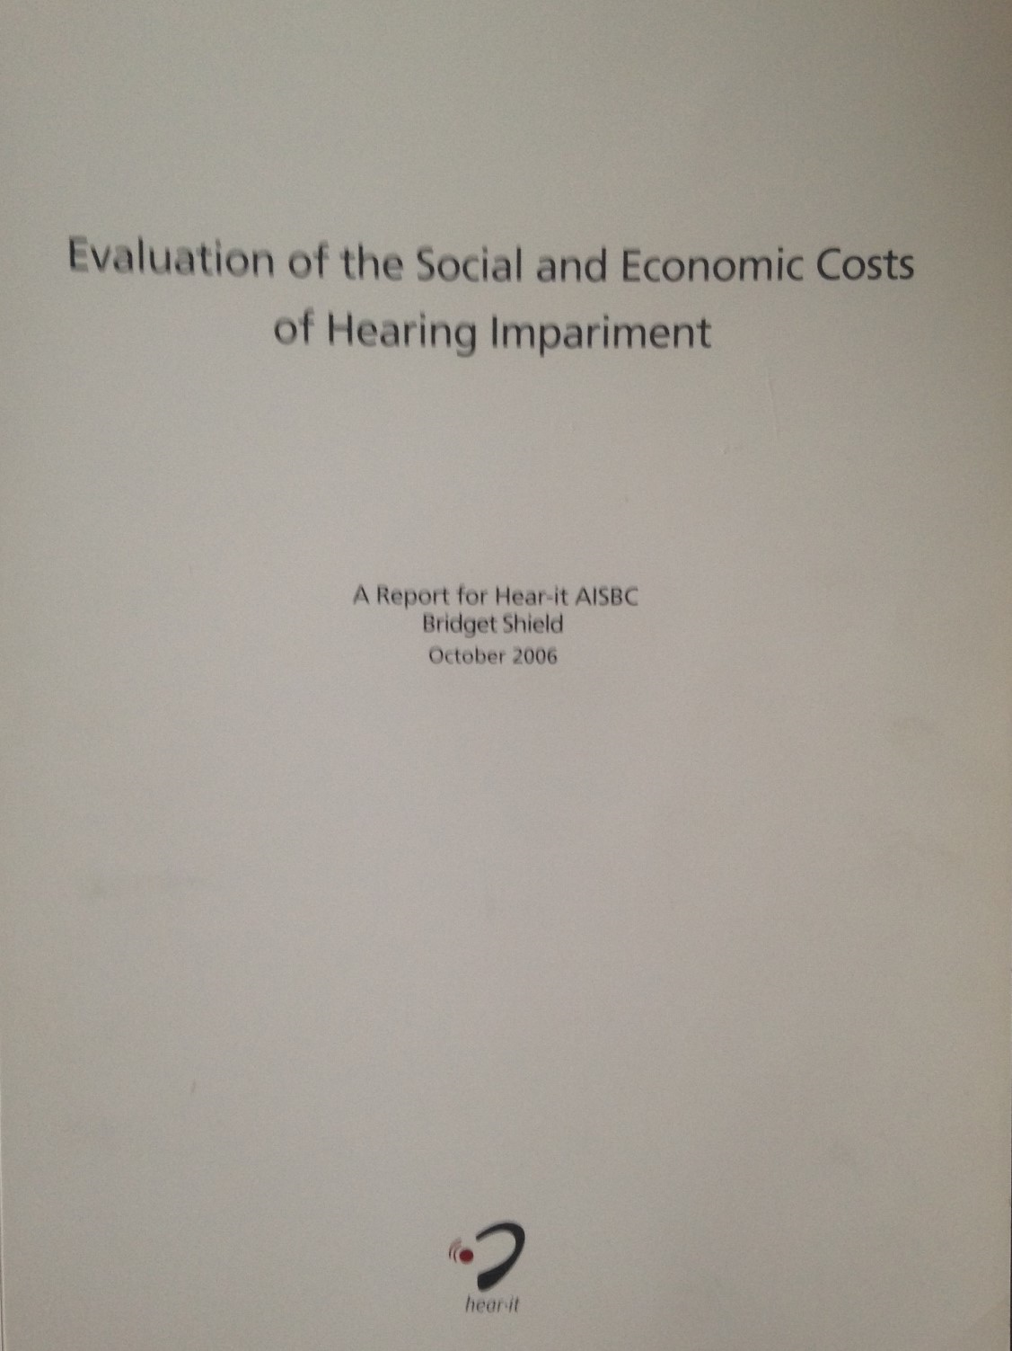

Background
Original report published 2006
Commissioned by Hear-It/
  EHIMA
Approached in autumn 2015 re update of 2006 report
1st draft completed autumn 2018
Launched in Brussels, March 2019
Available at www.hear-it.org or www.ehima.com

Slide 3
Topics covered in 2019 report
Definitions of Hl
Prevalence of HL in Europe
Self reporting v audiometry
Psychosocial effects
Impact on physical health
Relationship with dementia
Impact of hearing loss on employment and earnings
Ownership, use and benefits of hearing aids
Studies of costs of hearing loss
Calculation of costs of hearing loss in Europe

Slide 4
Prevalence of hearing loss

Slide 5


Prevalence of hearing loss:
Global Burden of Disease studies
Carried out since 1990
Gather together all available epidemiological data on prevalence and incidence of disease
  ~ 300 diseases in 195 countries
Initially carried out by Harvard and WHO, funded by World Bank
Now coordinated by Institute for Health Metrics and Evaluation (IHME), based in Seattle
Funded by Bill and Melinda Gates Foundation
Results published annually in Lancet and on IHME and WHO websites
Hearing loss included since 2010

Slide 6
Other surveys
Eurotrak and Marketrak consumer surveys
Research studies
Large scale population studies
  implications of ageing population

Slide 7
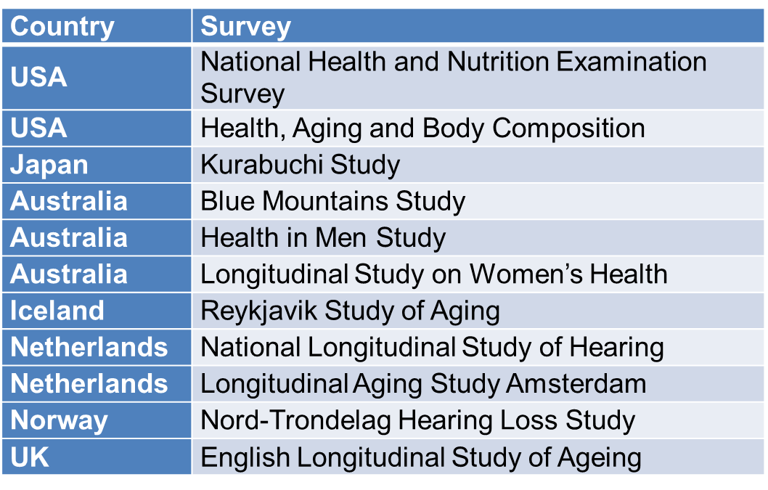
Other surveys
Eurotrak and Marketrak consumer surveys
Research studies
Large scale population studies
  implications of ageing population

Slide 8
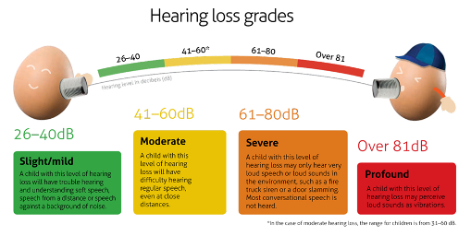

Definitions of hearing impairment

Slide 9
Definitions of hearing impairment
Grade of hearing loss | WHO | GBD | ASHA | AHL
Slight |  |  | 16 – 25 dB
Mild/slight | 26 – 40 dB | 20 – 34 dB | 26 – 40 dB | 25 – 39 dB
Moderate | 41 – 60 dB | 35 – 49 dB | 41 – 55 dB | 40 – 69 dB
Moderately severe | --- | 50 – 64 dB | 56 – 70 dB | ---
Severe | 61 – 80 dB | 65 – 79 dB | 71 – 90 dB | 70 – 94 dB
Profound | ≥ 81 dB | 80 – 94 dB | ≥ 91 dB | ≥ 95 dB
Complete |  | > 94 dB
Disabling hearing loss in adults | >40 dB in better ear | >35 dB in better ear

Slide 10
Self-reported or measured hearing loss?
SR underestimates prevalence of mild hearing loss
Younger people overestimate HL in SR surveys
Older people underestimate HL in SR surveys
Overall, SR surveys underestimate prevalence
  overestimate prevalence among younger people
  underestimate prevalence among older people
In SR surveys, use of a simple, single question is as reliable as more detailed questionnaire surveys
  eg ‘Do you have difficulty with your hearng?’
Need combination of SR survey and audiometry

Slide 11
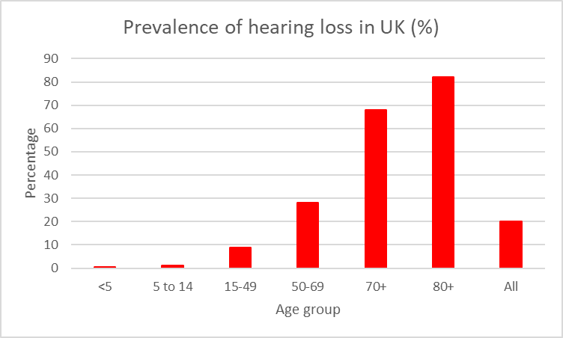
Percentage of hearing impairment (> 20 dB) across age groups in UK (GBD 2017 data)
20% of the population are hearing impaired
Nearly 70% of over 70s are hearing impaired
Over 80% of over 80s are hearing impaired

Slide 12
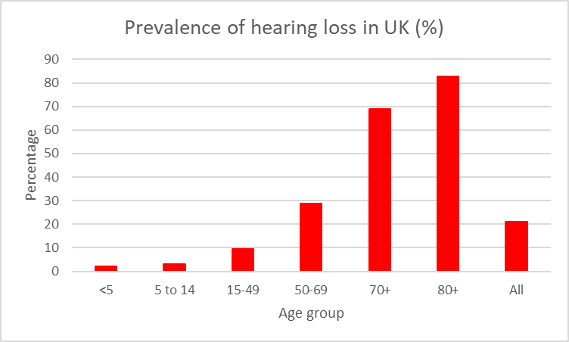
Percentage of hearing impairment (> 20 dB) across age groups in UK (GBD 2017 data)
21% of the population are hearing impaired
Nearly 70% of over 70s are hearing impaired
Over 80% of over 80s are hearing impaired

Slide 13
Numbers with hearing impairment (> 20 dB) across age groups in UK (GBD 2017 data)
13 million people have hearing loss > 20 dB
~ 9.3 million people have hearing loss > 25 dB
~4.6 million people have hearing loss > 35 dB

Slide 14
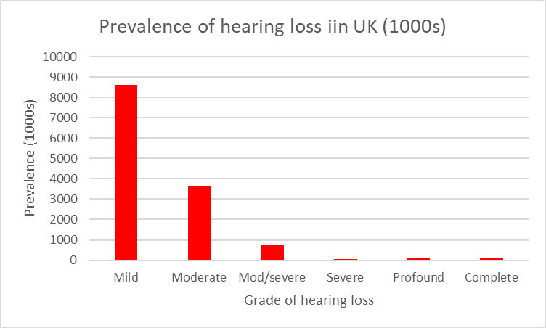
Numbers (all ages) with different grades of hearing loss in UK (GBD 2017 data)
8.6 million people have mild hearing loss
3.6 million people have moderate hearing loss
~ 1 million people have hearing loss > 50 dB

Slide 15
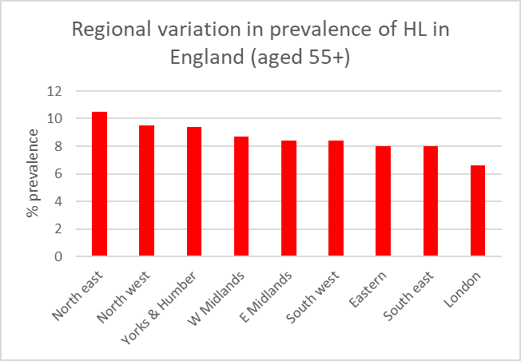
Regional variation in prevalence in England
(from Davis in CMO report, 2012)

Slide 16
Increase in prevalence of hearing loss
Global prevalence increasing (Olusanya et al, 2014)
  increase in life expectancy
  ototoxic medications
  earlier diagnosis
  diseases (eg rubella)
  noise induced hearing loss
European prevalence increasing (Davis et al, 2009)
  1 in 6 in 2009; 1 in 4 in 2050
UK prevalence increasing (AHL, 2011; 2015)
  1 in 6 in 2011; 1 in 5 in 2030

Slide 17
Increase in prevalence of hearing loss
Global prevalence increasing (Olusanya et al, 2014)
  increase in life expectancy
  ototoxic medications
  earlier diagnosis
  diseases (eg rubella)
  noise induced hearing loss
European prevalence increasing (Davis et al, 2009)
  1 in 6 in 2009; 1 in 4 in 2050
UK prevalence increasing (AHL, 2011; 2015)
  1 in 6 in 2011; 1 in 5 in 2030
Two US studies suggest prevalence is stable or decreasing
  improved economic and social welfare
  better medical care of children
  reduction in occupational noise exposure

Slide 18
Increase in prevalence of global hearing loss
(WHO, 2018)

Slide 19
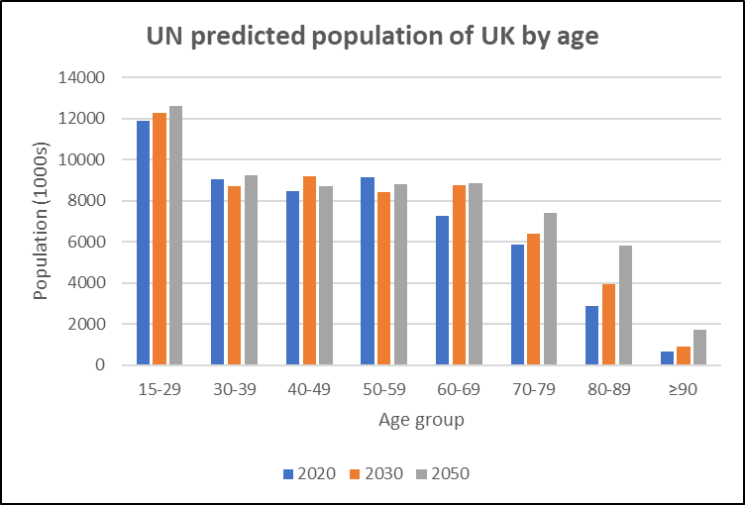
Change in age profile of UK population over next 30 years (based on UN data)

Slide 20
Impacts of hearing loss

Slide 21
Psychosocial impacts of hearing loss
Family/personal
relationships
Hearing loss
Loneliness
Depression

Slide 22
Psychosocial impacts of hearing loss
Family/personal
relationships
Hearing loss
Loneliness
Depression
Reduced quality of life
Increased risk of
early death

Slide 23
Impact of hearing loss on physical health
Mortality
Falls/
slower gait
Co-morbidity
eg diabetes
Hearing loss
Health
related
QoL
Activities
of daily
living/
disability

Slide 24
Impact of hearing loss on physical health
Mortality
Falls/
slower gait
Co-morbidity
eg diabetes
Hearing loss
Health
related
QoL
Activities
of daily
living/
disability
Cardio-
vascular
health
???
Strokes
???

Slide 25
Health impacts of hearing loss
Mortality
Falls/
slower gait
Co-morbidity
eg diabetes
Hearing loss
Health
related
QoL
Activities
of daily
living/
disability
HRQoL: Hearing loss has greater impact than diabetes, hypertension, angina, sciatica, heart failure

Slide 26
Mortality
Longitudinal studies over 3 to 10 years have found hearing loss related to increased risk of mortality.
Recent studies (2017, 2018) over longer time periods found no significant association when correcting for confounding factors.
Overall, results inconclusive

Slide 27
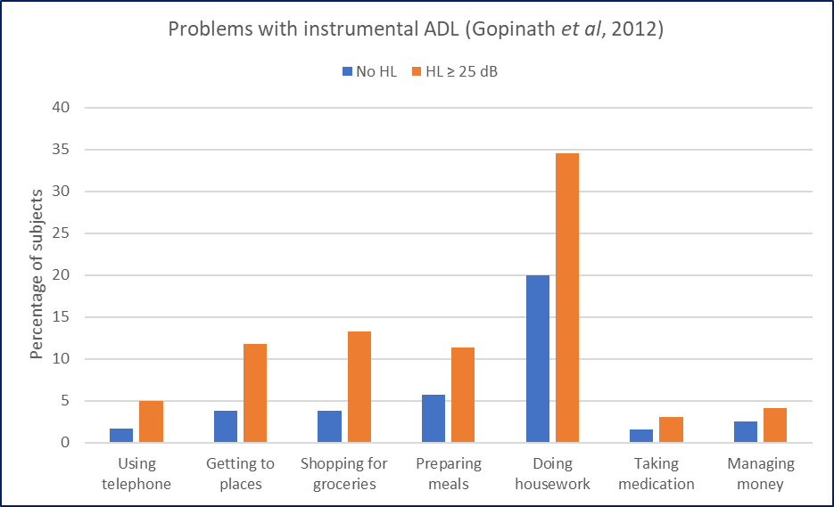
Disability/activities of daily living (ADL)
Results from Gopinath et al (2012)

Slide 28
Co-morbidity
Dizziness
Cancer
Hearing loss
Arthritis
High blood
pressure
Diabetes
Emphysema

Slide 29
Co-morbidity
Dizziness
Cancer
Hearing loss
Arthritis
High blood
pressure
Diabetes
Emphysema
DEMENTIA

Slide 30
Co-morbidity
Example (Stam et al, 2014)
Netherlands, ~2000 subjects, aged 18 to 70

Slide 31
Hearing loss and cognitive decline/dementia

Slide 32
Hearing loss and cognitive decline/dementia
Overall results – contradictory
Hearing loss is associated with reduced cognitive performance
Increase in hearing loss is associated with decrease in cognitive function
Relationship between hearing loss and cognition is complex
Some studies found that, after correcting for confounding factors (eg health, demographics), there was no association
Several theories have been put forward to explain the link
Similar symptoms of hearing loss and dementia
  social isolation, lack of comprehension, inappropriate word use, difficulty following conversation

Slide 33
Hearing loss and cognitive decline/dementia
Overall results – contradictory
Hearing loss is associated with reduced cognitive performance
Increase in hearing loss is associated with decrease in cognitive function
Relationship between hearing loss and cognition is complex
Some studies found that, after correcting for confounding factors (eg health, demographics), there was no association
Several theories have been put forward to explain the link
Similar symptoms of hearing loss and dementia
  social isolation, lack of comprehension, inappropriate word use, difficulty following conversation
  BUT…

Slide 34
Lancet Commission on Dementia Prevention, Intervention and Care
Livingston et al, 2017

Slide 35
Lancet Commission on Dementia Prevention, Intervention and Care
Livingston et al, 2017
35% of dementia cases are attributable to a combination of nine modifiable risk factors

Slide 36
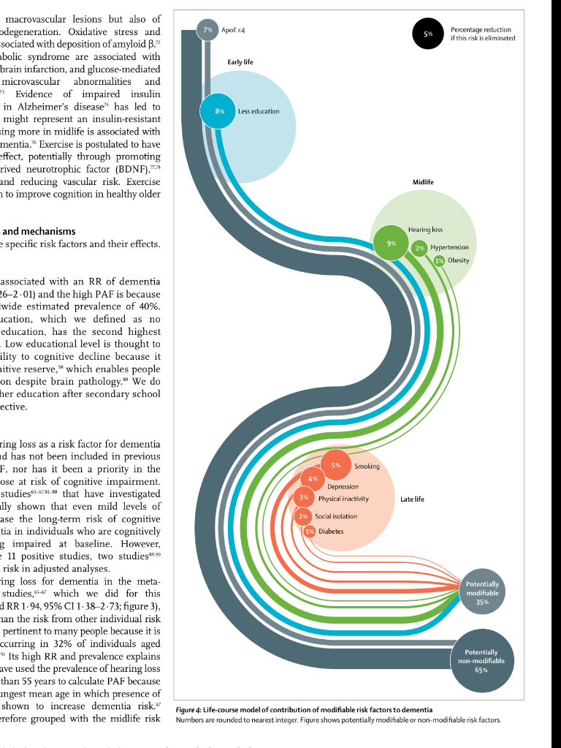
Risk factors for dementia

Slide 37
Risk factors for dementia
 | Risk factor | Relative contribution
Early life | Less education | 8%
Mid life | Hearing loss | 9%
 | Hypertension | 2%
 | Obesity | 1%
Late life | Smoking | 5%
 | Depression | 4%
 | Physical inactivity | 3%
 | Social isolation | 2%
 | Diabetes | 1%

Slide 38
Risk factors for dementia
Hearing loss in middle age is greatest modifiable risk factor
for dementia
Managing hearing loss in middle age could potentially eliminate 9% of cases of dementia

Slide 39

Hearing aids

Slide 40
Ownership of hearing aids in UK: results of various surveys
Survey/authors | Age of subjects | Ownership of hearing aids
 |  | % HI owning HA | Number without HA
Health Technology Assessment Davis et al, 2007 | 55-74 | 23
Action on Hearing Loss, 2011 | ≥ 16 |  | 4 million
Davis and Smith, 2013 | > 60 | 24 | 3.8 million
British Regional Heart Study Liljas et al, 2013 | 63-85 | 59
Health Survey for England Scholes and Mindell, 2015 | ≥ 16 | 28 | 4 million
Action on Hearing Loss, 2015 | ≥ 17 |  | >4 million
Eurotrak 2018 | ≥ 18 | 48

Slide 41
Ownership and use of hearing aids
  Ownership increases with age and severity of HL
  At least 40% of people world wide who need HA do not have them
  Around 25% of HA owners do not use them
  ~ 9 million people in UK who could benefit from HA do not use them (Davis, 2018)

Slide 42
Factors related to non-ownership/use of HA
  Perceived lack of need
    typical delay of 10 years on average
    delays of over 50 years reported
  Discomfort
  HA do not restore hearing to normal
  HA not satisfactory in noisy situations
  Stigma
    not as great a problem as previously
  Difficulty in manipulation and maintenance
    exacerbated by visual difficulties and lack of dexterity
  Lack of adequate information and follow up support
  Worsening HL and family pressure main reasons for seeking help

Slide 43
Reported benefits of HA
  Improvements in quality of life
  Less stigma
  Improvements in family relationships
  Improvements in general health
    better sleep, less depression, better memory
  Improvements in effectiveness of communication
  Reduction in rate of cognitive decline
  Impact on earnings and employment

Slide 44
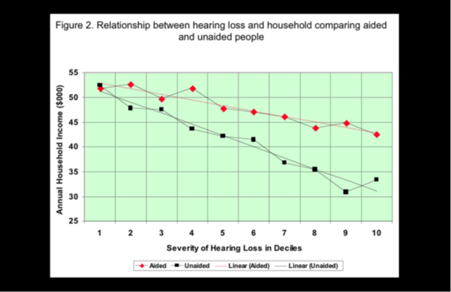
Impact of HA on household income
(Kochkin, 2007)

Slide 45
Satisfaction with HA
(Eurotrak data)
  Over 70% of owners are satisfied with their HA
  Satisfaction has increased over past 30 years
  1-1 conversation is situation in which HA provide most satisfaction
  Group conversation is situation in which HA provide least satisfaction
  Background noise is often a problem

Slide 46
Implications for acoustic design
  The acoustic environment must be designed for use by everyone
  Around 1 in 5 people who currently use buildings and other spaces are hearing impaired
    will be 1 in 4 in 30 years’ time
    even those with hearing aids still have hearing problems
  ‘Accessibility’ includes appropriate acoustic design for use and enjoyment by people who are hearing impaired
    speech intelligibility
    acoustic comfort
    ease of 1-1 communication
    ease of group communication
    minimising background noise

Slide 47
Thank you for listening!
shieldbm@lsbu.ac.uk
ANC Conference
Manchester, June 6th, 2019

