Slide 1
Agent of change
Saviour of grassroots music venues?

Slide 2
Lindsay McIntyre director
KSG acoustics

Slide 3

Once upon a time, our city centres buzzed with industry…

Slide 4
Glasgow’s shipyards were the beating heart of the city…
But it couldn’t last forever…

Slide 5
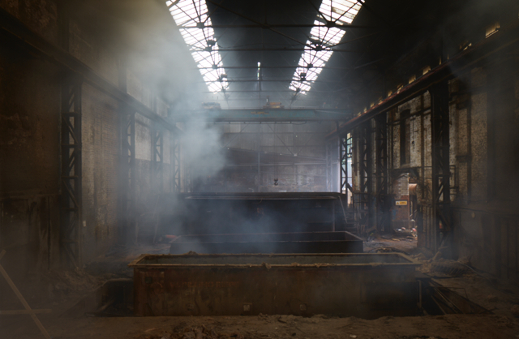
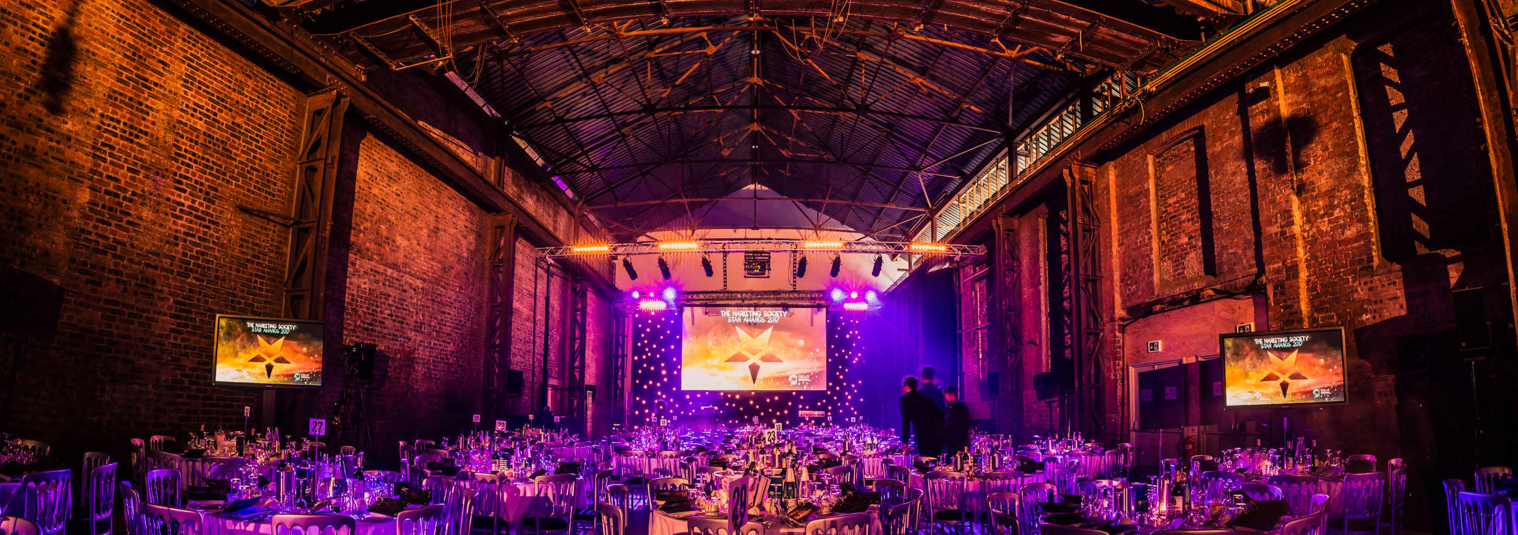
Over time, the places we live have changed…
Clydeside Galvanizers
The Galvanizers @ SWG3

Slide 6

…and urban living is back
Land use has changed
Industry left the city centres
Retail and commercial use took over, interspersed with growing music and entertainment uses
On-line retail, economic factors, demand for flexible working and a desire for fewer vehicles entering the city has changed the shape of the land use again
Urban living has had a resurgence, with apartments springing up everywhere

Slide 7

So what’s the big deal?

Slide 8

The value of the UK music industry
£4.5 billion total gross value added contribution generated by the UK music industry
£2.6 billion total export revenue generated by the UK music industry
145,815 total full time equivalent UK employment sustained by music in 2017
“the world’s largest exporter of music outside of the US”
Music industry is worth £334 million to the Scottish Economy
Source: UK Music Measuring Music 2018 Report

Slide 9

So why do grassroots venues matter then?
Grass roots venues are essential for musicians, artists and technical specialists to learm their trade
Talent is developed, collaborate and hone their craft
Audiences access music across a wide range of genres, increasing cultural exposure in an affordable environment
The industry supports job creating, urban regeneration and the attraction of international and domestic visitors
35% of music venues have closed over the past decade
Venues are facing tougher licencing laws, unwelcoming neighbours, aggressive development and increasing property vales and rates
Every venue that closes represents the loss of a local business together with the loss of jobs
Closures also deprive artists of places to play and audiences of a valied live music expereince

Slide 10

Glasgow’s music venues are under pressure, despite its unesco city of music status

Slide 11

Agent of change – what is it then?
“The Agent of Change Principle is not complicated or controversial, it’s simple common sense: Agent of Change says that the person or business responsible for the change is responsible for managing the impact of the change” Music Venues Trust
“Complaints about noise nuisance can place particular pressure on our music venues, potentially leading to additional costs for them to remedy negative impacts, or cease certain operations such as live music, or to endanger the viability of the business altogether.
The Agent of Change principle clearly places the responsibility for mitigating any detrimental impact of noise on neighbours with those carrying out the new development or operations.” The Scottish Government

Slide 12

The aussies got there first though…

Slide 13
Victorian state government Planning Scheme Amendment VC120 Clause 52.43
Implements the principle of Agent of Change
Applies to a planning permit application for a live music entertainment venue or a noise sensitive residential use within 50m of a live music entertainment venue
A permit application for a live music venue must be designed, constructed and managed to minimise noise emissions from the premises and provide noise control measures that will protect a noise sensitive residential use within 50m
A permit application for a noise sensitive residential use must be designed and constructed to include noise control measures that will reduce noise levels from any indoor live music venue to below the noise limits specified in SEPP N-2; outdoor live music entertainment venue to below 45dB(A), assessed as an Leq over 15 mins

Slide 14

SEPP N-2???
SEPP N-2 noise standards were developed specifically to protect residents from potential music noise impacts
It sets variable limits for day and night time for noise ingress to habitable rooms from indoor venues. These are:
Daytime: LA90 + 5dB; and
Night time: Loct90 + 8dB (frequency specific)
Provision for infrequently operating premises to have ‘slightly higher noise levels’ (+3dB for up to 10 gigs per year)
Also, outdoor concert venues: 65dB(A) of 55dB(A) when measured inside a residence (6 concerts per year)
An existing venues compliance, or not, with SEPP N-2 does not change a residential developer’s obligation under Clause 52.43 to satisfactorily protect a new residential use from existing noise emissions.

Slide 15
Meanwhile, in the UK…
The UK government incorporated the principle of Agent of Change into the National Planning Policy Framework in July 2018
Clause 182 states that “Planning policies and decisions should ensure that new development can be integrated effectively with existing business and community facilities. Existing businesses and facilities should not have unreasonable restrictions placed on them as a result of development permitted after they were established. Where the operation of an existing business of community facility could have a significant adverse effect on new development… in its vicinity, the applicant (or agent of change) should be required to provide suitable mitigation before the development has been completed”

Slide 16

Planning (Agent of Change) Bill 2018-19
Passed first reading in the House of Commons on 10 January 2018
Bill withdrawn on Monday 10 September 2018.
So can Planning Policy fill the gap?
Or can the only challenge to a statutory nuisance claim be legislation?

Slide 17
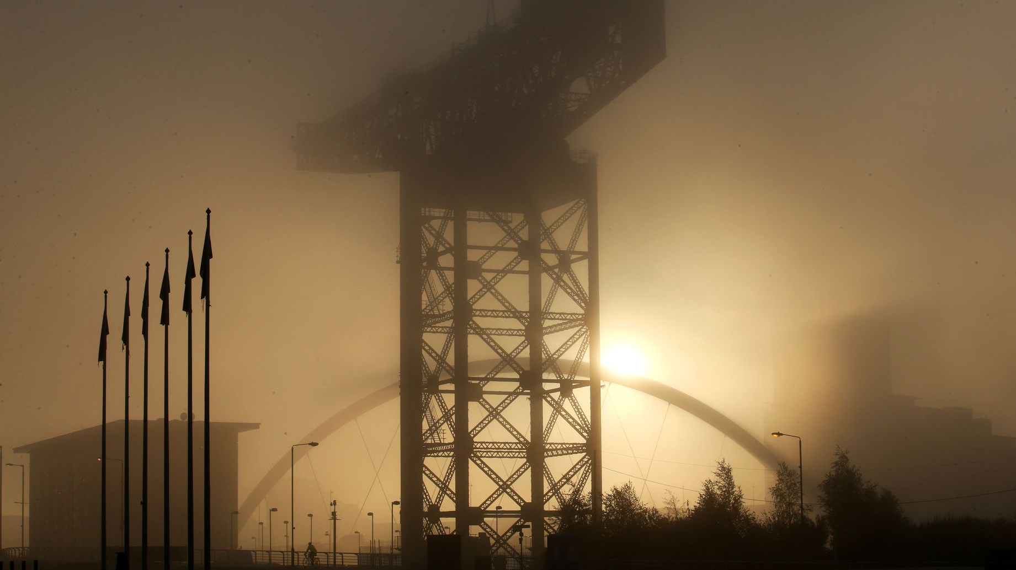
So what have you lot been up to in Scotland then…?

Slide 18

Agent of change in scotland

Slide 19

Agent of Change in Scotland
A group of influential Scottish Music Industry individuals and technical advisers formed with the intention to kick-start the conversation about Agent of Change in Scotland. We used word of mouth and social media to spread the word, buoyed by a wave of interest across the UK
The group was eventually invited to Scottish Parliament to meet Kevin Stewart MSP Minister for Local Government, Housing and Planning
Letter issued by the Chief Planner to all Local Authority Heads of Planning, instructing them to implement Agent of Change when considering the interaction between live music venues and noise sensitive development
“I am attracted by the prospect of embedding the Agent of Change principle into our planning system so that we can protect the established and emerging talent in our music industry. Our live music venues should not become financially disadvantaged or have their viability threatened as a result of new development in their vicinity.”
“The Agent of Change principle clearly places the responsibility for mitigating any detrimental impact of noise on neighbours with those carrying out the new development or operations.”

Slide 20
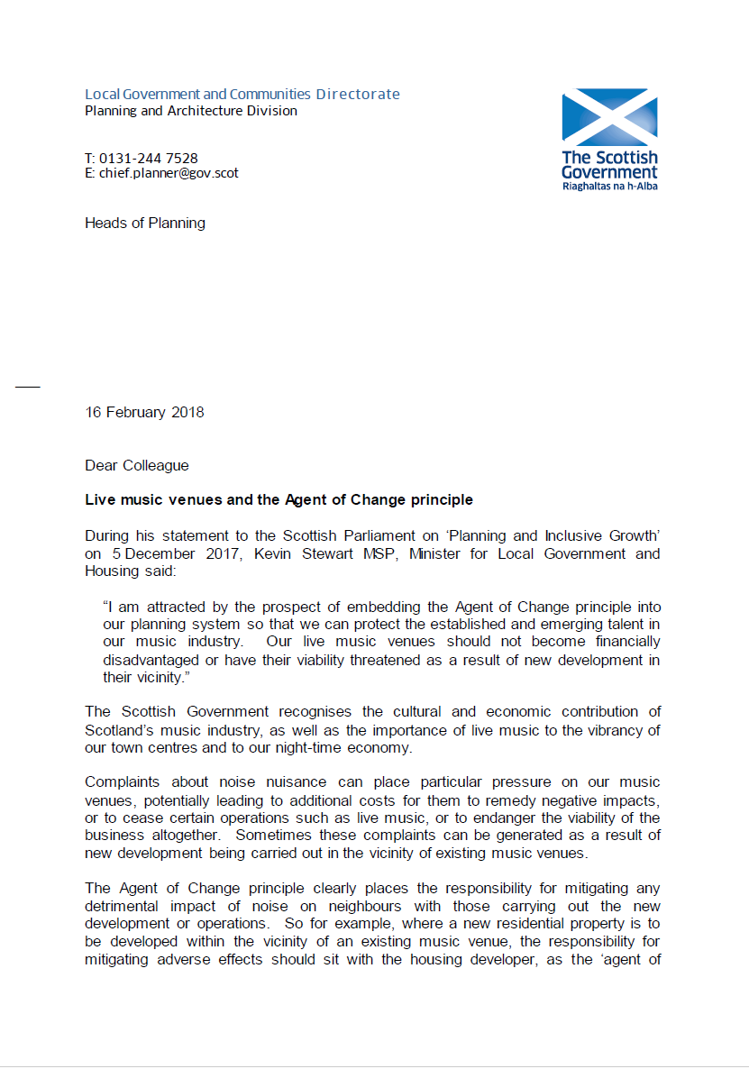
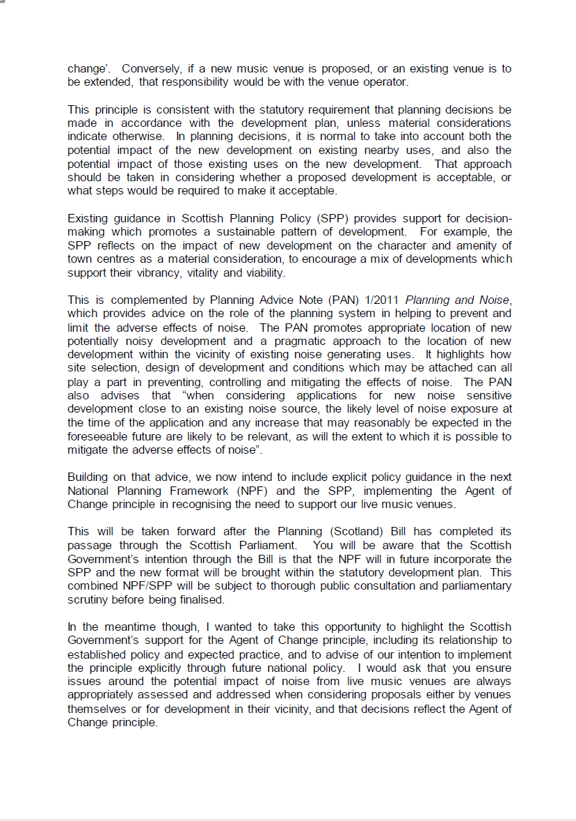
Letter from the Chief Planner

Slide 21
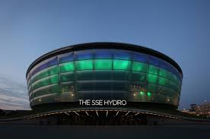
Planning (Scotland) bill

Slide 22
Locking down Agent of Change?
Further to the Chief Planner’s letter, attention turned to the Planning (Scotland) Bill
Amendments to the Bill are intended to improve the system of development planning, giving people a greater say in the future of their places
After written submissions to a Call for Evidence, members of the Music Industry team were invited to oral sessions at Holyrood to allow the Planning Bill Committee to hear about the challenges for live music venues in a changing urban environment
There remined uncertainty whether the Bill was the right place for Agent of Change due to its technical complexities but it was agreed that a mention of it at least would cement the Principle in law
Amendments to the Bill to include Agent of Change were submitted by 3 MSPs for debate…

Slide 23
Scottish National Party (SNP) Amendment
…require that an application for planning permission for development… be accompanied by a statement about the likely impact of noise from existing uses of land in the vicinity of the development on occupants and other users of the development
Before Planning Permission is granted… the authority must consider the likely impact of noise from existing uses of land in the vicinity of the proposed development (particularly land used for the performance of live music) on occupants and other users of the proposed development
Where a planning authority grant planning permission for development… the notice must specify why the authority are satisfied that the likely impact of noise will be acceptable

Slide 24
Conservative amendment
A development that is the subject of an application for planning permission is a noise sensitive development if residents or occupiers of the development are likely to be affected by significant noise from existing activity in the vicinity of the development
Without prejudice… a planning authority may not, as a condition of granting planning permission for a noise sensitive development impose on a noise source additional costs relating to acoustic design measures to mitigate, minimise or manage the effects of noise

Slide 25
Labour amendment
Culturally Significant Zones
A planning authority may designate a culturally significant zone
The purpose is to identify protect and enhance existing cultural venues, facilities and uses, identify and support the development of new cultural venues, facilities and uses, and ensure no unreasonable consequences for the operation of existing cultural venues or facilities is created in relation to new development within the zone
A planning authority must consider any valid request for them to designate a culturally significant zone for their district

Slide 26

And the result?
After vigorous Parliamentary debate, Conservative and Labour amendments were passed (including the Culturally Significant Zones!)
SNP amendment was not passed

Slide 27
Hot off the press…
A meeting of the Scottish Music Industry group with the Bill Manager and other members of the Planning (Scotland) Bill committee was held earlier this week
There is concern over the sheer number of amendments to the Planning (Scotland) Bill and the ‘workability’ of the more complex and detailed proposals
Conservative amendment is still likely to stand in its current form and (all else being equal) will make it into the Bill later this Summer

Slide 28
Glasgow City Council licencing policy statement

Slide 29

GCC licencing policy statement
GCC has recently published its revised Licencing Policy statement
Section 2.4.12 is a new addition and introduces Agent of Change
The section states “The Licencing Board believes it is appropriate to have regard to the Agent of Change principle in considering licence applications and, in particular the weight to be attached to objections to applications for variation of premises licences and to complaints regarding the operation of existing licenced premises.”

Slide 30

So what else do we need to actually make a difference?
Policy!
And revised guidance, which makes specific reference to music and entertainment (Planning Advice Note (PAN) 1/2011) Planning and Noise

Slide 31

The XX play two sold out shows in the Galvanizers Yard, August 2017

Slide 32

Hive mind…
Should Agent of Change really be specific to music and entertainment or should any reference in the Planning (Scotland) Bill avoid referring specifically to music at all?
Should we have a good Practice style document to assist Planners and EHO to a) trigger a request for a Noise Impact Assessment early; and b) check whether the report they receive is fit for purpose?
Should a Noise Impact Assessment be listed on the Planning Application Form as a potential requirement (like Flood Risk, for example)
Should we consider draft Conditions and / or recommended design targets for ‘acceptable’ music and entertainment noise ingress?
Should Agent of Change apply to spaces used occasionally (and maybe increasingly) for outdoor events (e.g. public parks)?
Should there be any obligations on the existing music venue to manage their noise profile / be a ‘good neighbour’?
If so, should there be enforced through licencing?
What about the other aspects that draw complaint (load in / load out, patron ingress and egress etc.)
Should landlords be able to make decisions on behalf of their tenants above what is ‘acceptable’?

Slide 33
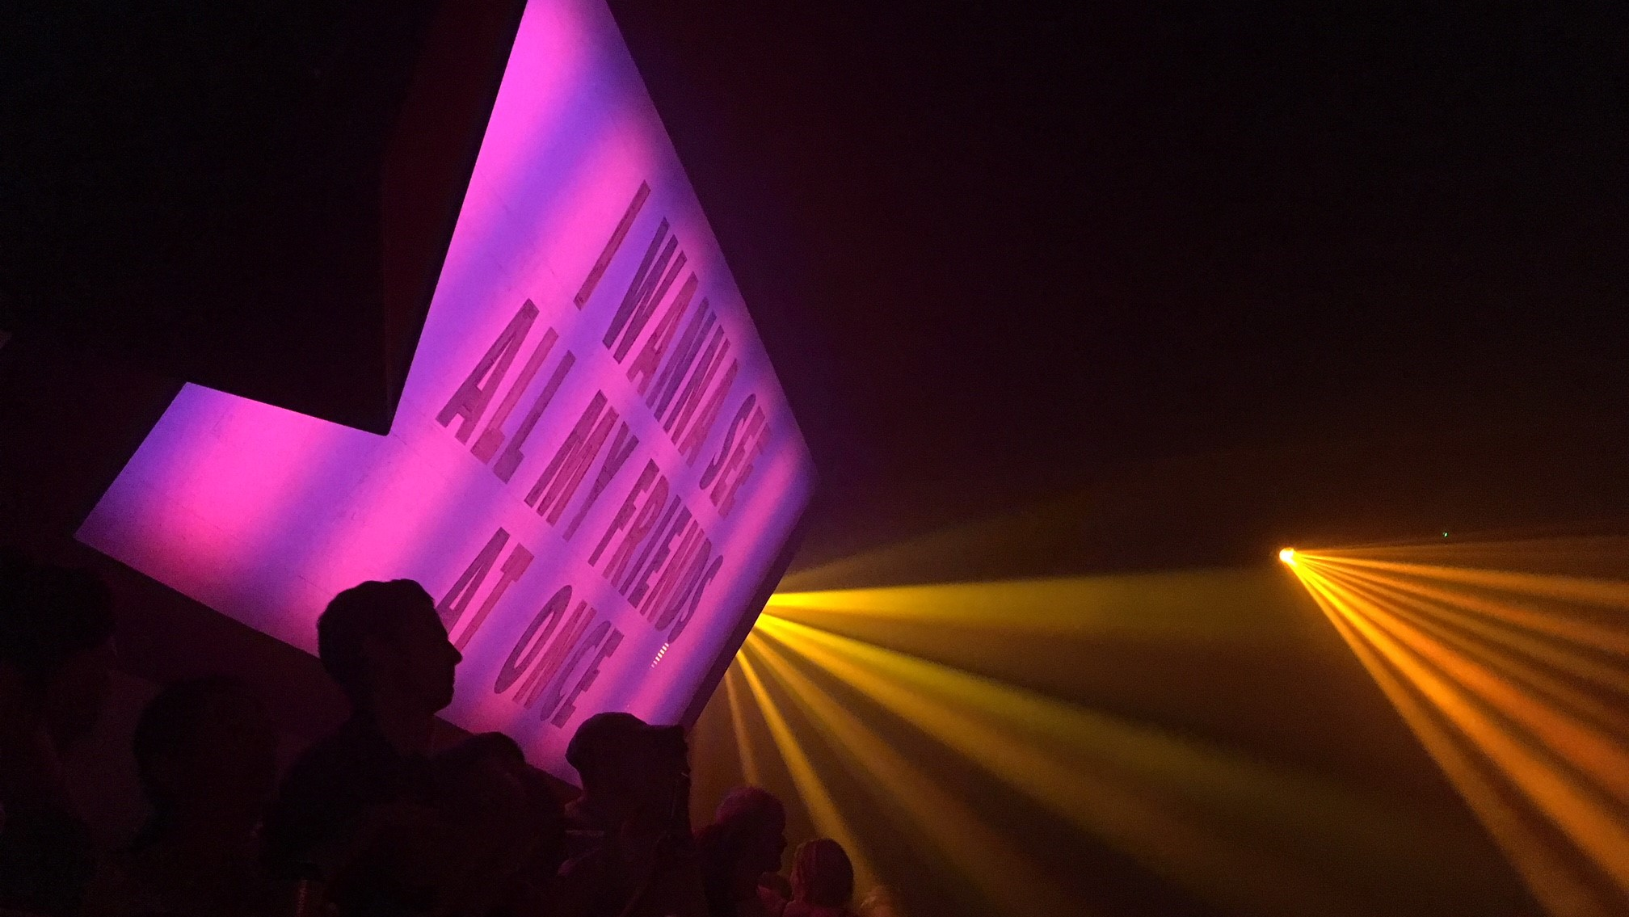
Any questions?

Slide 34

LINDSAY MCINTYRE
KSG ACOUSTICS
LINDSAY@KSGACOUSTICS.CO.UK

