Slide 1

ANC 2019 Conference, Manchester
Children with hearing loss in mainstream classrooms and implications for acoustic design
Emma Greenland PhD BEng MIOA
Anderson Acoustics

Slide 2

Aim :
To establish reasonably adjusted acoustic criteria (robust, practicable) to ensure that the acoustic design does not place people with disabilities at a disadvantage.
Reason: To improve access to the mainstream classroom by disabled children.

Slide 3
Requirements and Drivers
Building Regulations
Approved Document E, BB93
Approved Document M, BS 8300: 2018
EFSA Output Specification
The Equality Act
Public Sector Equality Duty

Slide 4

The Public Sector Equality Duty
Public bodies in England (and non-devolved bodies in
Scotland and Wales)

Slide 5
Who the general duty applies to
Public authorities listed in Schedule 19 of the Equality Act (e.g. local authorities, FE and HE bodies, schools, health bodies, police, fire and transport authorities, government departments).
Public, private, or voluntary organisations carrying out public functions (including on behalf of a public authority). The Equality Act uses the same definition as the Human Rights Act 1998 (which was used for the gender and disability equality duties).

Slide 6
In order to fulfil their duties under the Equality Act 2010, school client bodies should anticipate the needs of deaf and other disabled children as current and potential future users of the school.
(Building Bulletin 93)

Slide 7






‘Deaf and other Disabled Students’ – The BB93 Definition
Mild or temporary hearing impairment
Permanent hearing impairment
Speech, language & communication needs
‘Special hearing & communication needs’, SHCN
AD/HD, Autistic spectrum disorder
Auditory processing disorder
Visual impairment

Slide 8


The Public Sector Duty
…says that protected groups must not be placed at a disadvantage.
It requires all schools to prepare and implement an accessibility strategy to improve the physical environment of the school for pupils with SEND, including those with Special Hearing and Communication Needs:
by making reasonable adjustments to put children with SEND on a more level footing.
The Equality Act also covers age discrimination:
and people with English as an Additional Language (EAL):
Both may be disadvantaged by poor acoustic conditions and so the needs of these protected groups must also be considered.

Slide 9
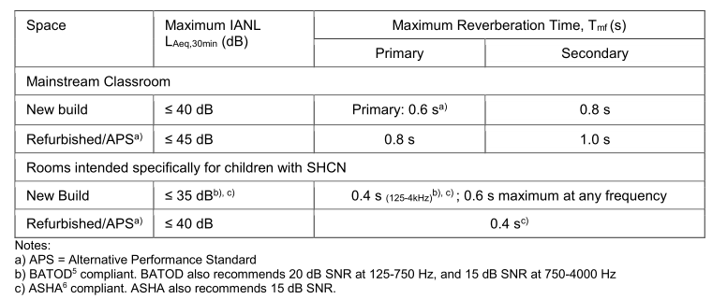
Requirements (BB93)
SEN rooms, designated units or specialist resource provision
Practicable for smaller rooms (low occupancy, high staff:student ratio)
Shorter RT for younger children
Based on assumed vocal effort and communication distance for SNR
15 dB SNR recommended by ASHA, 20 dB SNR recommended by BATOD

Slide 10
Requirements
School Premises Regulations
“where pupils with special needs are taught in mainstream schools, the acoustics of the spaces where they are taught may need to be enhanced to the same standards as those special units”,
“provision will usually be required to teach these pupils in smaller groups so that noise from other pupils is lower and the distance between teacher and pupil is minimised”.
IOA/ANC Design Guide
Pupils with SHCN should be taught in rooms which meet BB93 acoustic criteria for SHCN rooms.
‘specialised provision may be directly attached to a mainstream class in the form of a ‘quiet room’ leading from the classroom’.

Slide 11
Requirements
The Equality Act 2010 requires schools to make
‘reasonable adjustments’ to put children with disabilities on a more level footing.
ESFA Output Specification
‘People with disabilities, including those with a hearing impairment, must not be placed at a disadvantage by the design of the Building’.
Ensure and demonstrate that all layouts allow for disabled pupils to be able to access all activities on offer in at least one space of each type or within each suite.
Sending children to an SHCN enhanced quiet room to access
the majority of their teaching and learning…
inclusive practice?

Slide 12



UN Convention on The Rights
of Persons with Disabilities
Article 24: A right to Inclusive Education
Guarantees all disabled pupils and students a right to participate in all forms of mainstream education with appropriate support.
UK has replaced restrictions on its obligations:
Definition of ‘general education system’ changed to
‘segregated education’ (Mainstream + Special Schools)
Reserves the UK’s right to send disabled children to special schools outside their local area.
It is the only country in the world apart from Mauritius to do so.

Slide 13



Prevalence of SHCN
Analysis of 2018 figures for state funded
primary and secondary schools

Slide 14






Prevalence – mainstream state schools
4.7m children
16,766 schools
3.2m children
3,436 schools
7.9m children in 20,202 schools
Mild or temporary hearing impairment
Permanent hearing impairment
Speech, language & communication needs
6%
SHCN
240,000 children
AD/HD, Autistic spectrum disorder
19%
1.5m children
Auditory processing disorder
EAL
4.7m children
Visual impairment
Young children

Slide 15
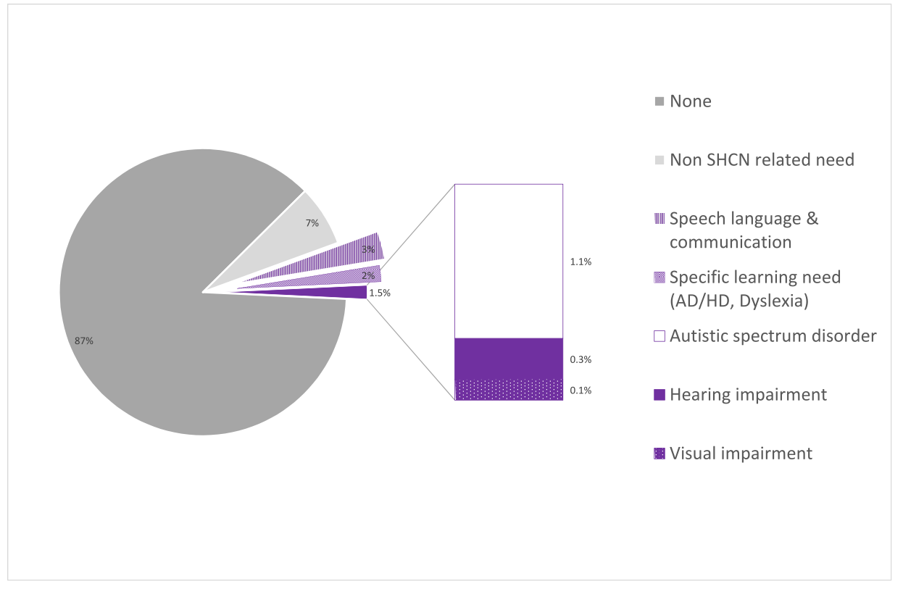
Prevalence – by individual need
23,000 HI children
up to 1 per primary school
up to 2 per secondary school

Slide 16





Prevalence – by typical classroom size
National averages should be treated with caution
Prevalence varies with individual school location and circumstances…
1 SHCN per classroom
2 SHCN per classroom
Special hearing & communication needs SHCN
English as additional language EAL
Young children (Primary schools)
but the need to provide appropriate conditions for children with SHCN should be anticipated in every classroom
Where there is significantly higher prevalence in a school cohort, consider specialist resource provision or designated unit

Slide 17
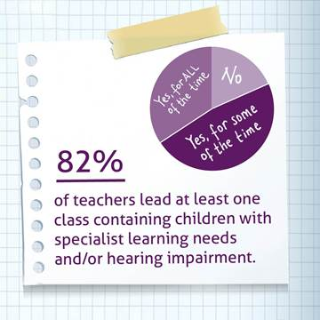
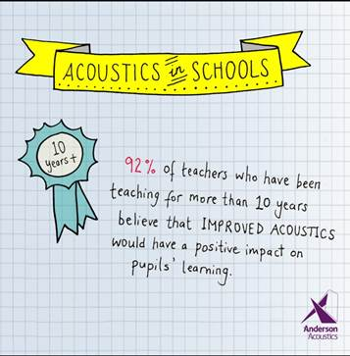
Prevalence – what the teachers say
Anderson Acoustics teacher survey 2016

Slide 18
Attainment – by individual need
Attainment gap for HI is significant (remember it’s not a learning disability), but it is smaller than for other forms of SHCN.
Attainment English + Maths
progress scores
-30%
-25%
-10%
EAL
Lower at start of school, eliminated by age 16

Slide 19
Quality of research
Attainment
Speech perception research quality
-30%
N/A
low
-25%
low
-10%
high
N/A

Slide 20
The challenge
how to improve accessibility

Slide 21
Constraints
Not feasible to apply BB93 enhanced standard to mainstream classrooms:
Providing sound absorption to achieve <0.4s T_{mf} vies with spare wall space, and trends for exposed soffits for sustainability
DfE budget does not allow for provision of extra bass sound absorption to achieve <0.6s T_{125Hz}
<0.4s T_{mf} not appropriate as early sound reflections needed to support teacher’s voice and avoid vocal strain.
Not feasible to target 30 dBA noise (number of children in the space, priority for natural ventilation, practicable limit that even the quietest natural ventilation systems can achieve).
The standard school building budget does not allow for provision of enhanced partition and door constructions to achieve enhanced sound insulation criteria.
Current funding crisis => diminishing resources to teach SHCN in small groups

Slide 22

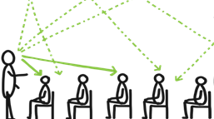

Reasonable adjustments - holistic approach
classroom management
listening aid
acoustic design
Company LOGO

Slide 23
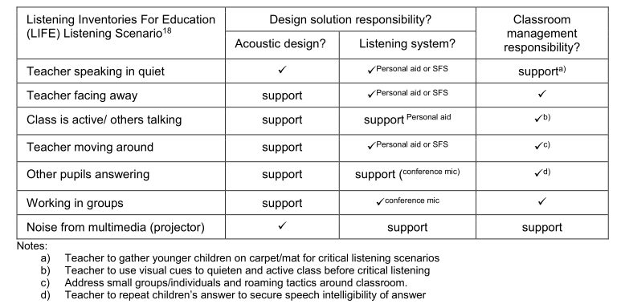

Classroom management
classroom management
‘effective classroom management by the teacher is critical in ensuring that the pupils can have access to all that is spoken’. (IoA/ANC Design Guide)
Primary responsibility of acoustic design is teacher-to-student comms in quiet.

Slide 24

Personal listening aids
listening aid
Given the low prevalence of SHCN, and the very low prevalence of children with hearing impairment, personal listening aids are feasible strategies to help boost acoustic conditions and support access to learning.
“personal listening aids enhance SNR,
reduce impact of unhelpful reverberation, particularly when a headset is used by the speaker”
IoA/ANC Design Guide
“if ambient noise level [SNR] is controlled then high RT has a minimal effect when a personal listening aid is in skilled use and set up properly”
British Association for Teachers of the Deaf (BATOD)
Image courtesy of Phonak

Slide 25
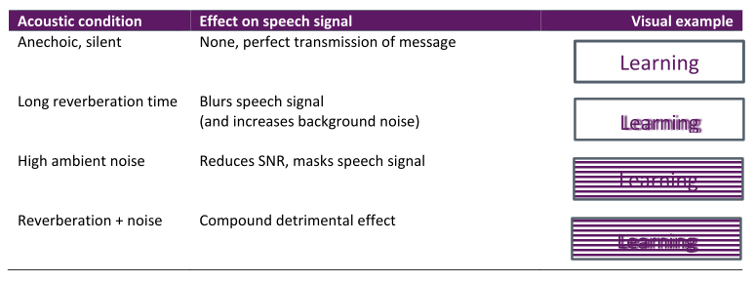
Factors Affecting Speech Perception
acoustic design
SNR is most important factor
RT also has an impact
0.2-0.5 s RT is ideal
but up to 0.9 s RT acceptable
(normal hearing children)
Non-zero RT to support voice:
≥ 0.5 s RT ideal
Low frequency RT control cited important for hearing impaired
… evidence?
…evidence when personal listening aid used?

Slide 26
The study
Quantifying the listening gap

Slide 27
Quantifying the listening gap
Seminal research studies reviewed, based on subjective speech perception testing, in varied acoustic conditions up to 1.0 s RT (flat-ish spectrum)
Listening gap: difference in % perception scores between ‘impaired’ and non-impaired groups
Reveals inherent % listening gap (ideal acoustic conditions)
acoustic % listening gap (non-ideal conditions)
consistencies between studies (systematic errors/variations reduced)
Note:
No studies analysed or controlled for age.
All studies used multitalker babble as noise source
Benefit of personal listening aids not investigated
Uplift in low frequency RT not investigated

Slide 28
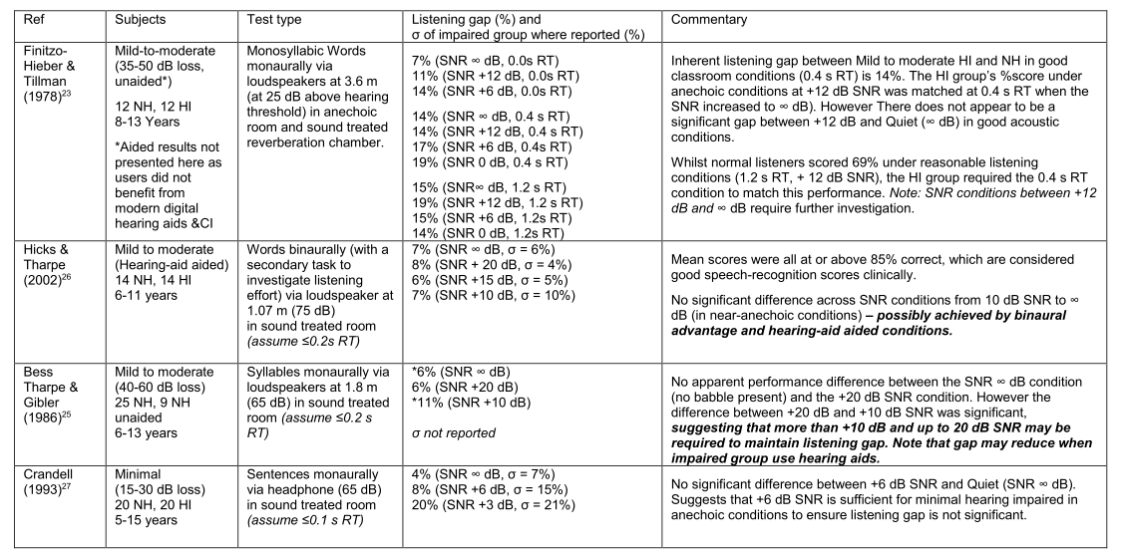
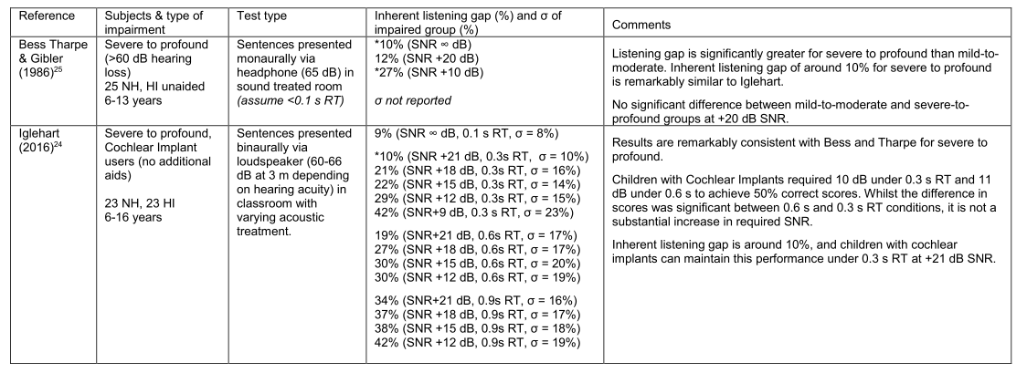
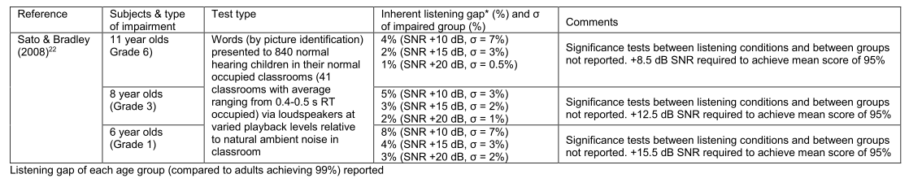
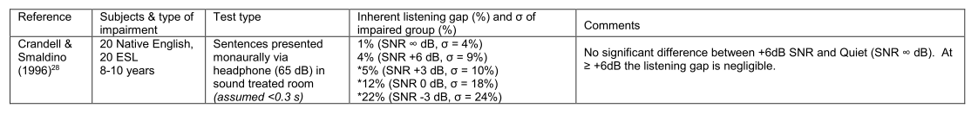
Results
Mild to moderate hearing Loss
AGE
Severe to profound hearing Loss
English as additional language
Minimal

Slide 29
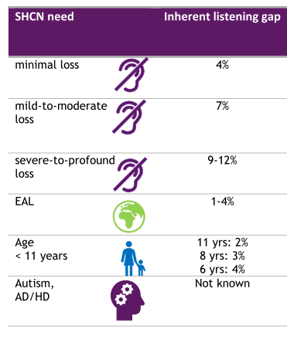
Results – inherent listening gap
For some needs, even in optimum acoustic conditions (silent, anechoic), children still experience reduction in speech perception scores compared to their typical peers:
Children with hearing loss are most disadvantaged.
Even when secondary school classrooms are BB93 compliant, listening disadvantage could be up to 40% (reducing to 20-30% with a personal listening aid).
For milder needs, inherent listening gap is small, 4% or less, not significant as comparable to variation within the impaired group.
However these needs are still significantly affected by poor acoustics. For example, in BB93 compliant primary school refurbs, the listening gaps could double.
Company LOGO

Slide 30
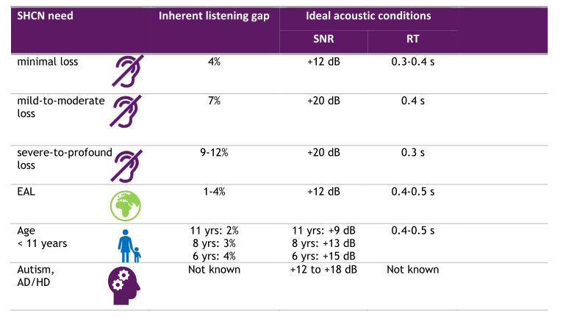
Results – ideal acoustic conditions
To eradicate additional listening gap caused by acoustics:
Company LOGO

Slide 31
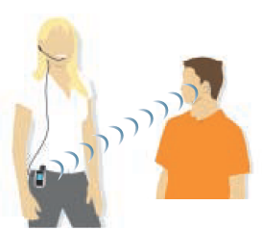

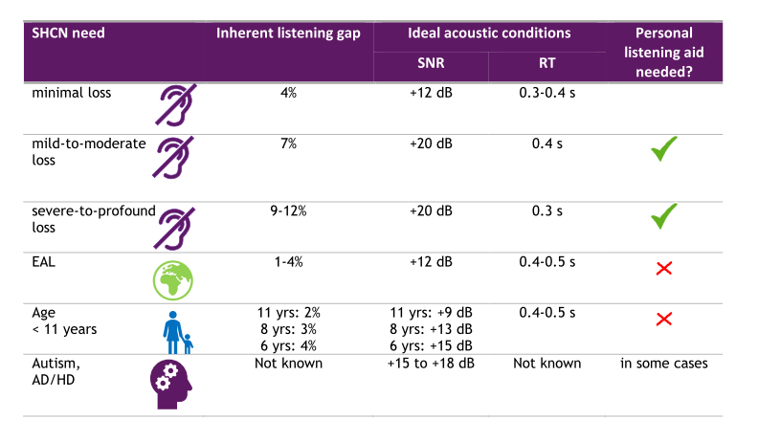
Boost from personal listening system
In BB93 compliant classrooms, even at good SNR of ≥15 dB, the listening gap for S-P hearing loss will be 30-40%
…but a personal listening device
> removes effect of reverberation
> boosts SNR.
Company LOGO

Slide 32
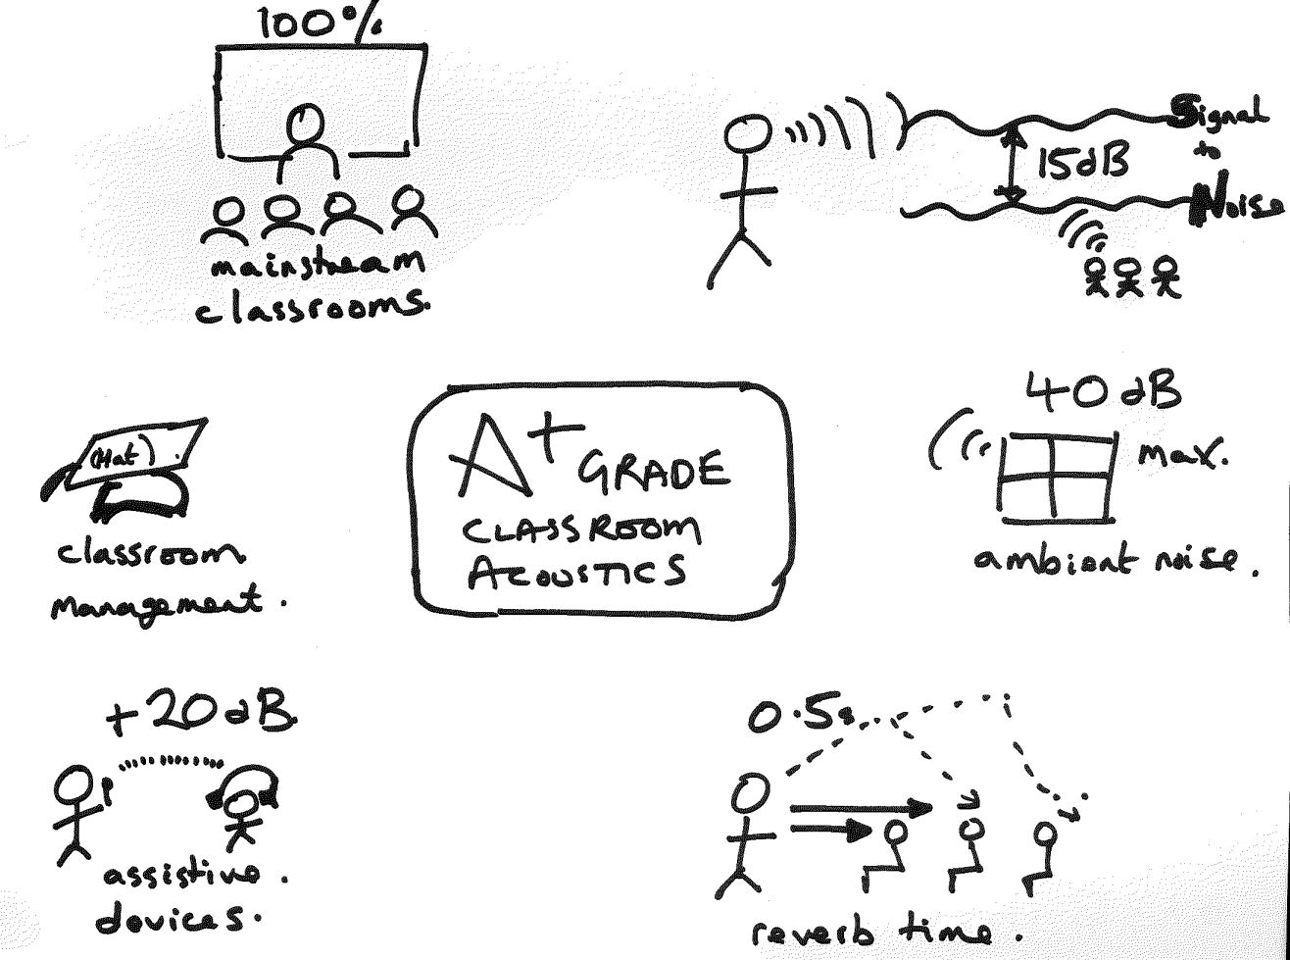
Recommendation – reasonable adjustments

Slide 33
Next steps for reasonably adjusted criteria for inclusion
DfE are looking at this issue for latest OS – November 2019
ANC/IoA Consultation on reasonably adjusted criteria
Cost of achieving 0.5 s T_{mf} against other design constraints
Evidence for reverberation time of 0.6 s at 125 Hz?
Use of personal listening systems
  Procurement
Views of other professionals:
  BATOD
  Educational audiologists
  Speech and language therapists

Slide 34
Feedback please!
emma@andersonacoustics.co.uk

