Slide 1
The challenges posed by the WHO Environmental Noise Guidelines for the European Region 2018
R. M. Thornely-Taylor
Rupert Taylor Ltd
ANC Annual Conference – 6 June 2019

Slide 2
Status of the WHO Guidelines
The UK has no statutory limits for noise
(except for motor vehicles and aircraft)
Much of our non-statutory guidance is traceable to WHO sources
Courts have frequently heard evidence about the acceptability of noise based on WHO Guidelines
“Guidelines for Community Noise” have been applied to a wide range of noise sources and receivers
Notes:
2

Slide 3
WHO Guidelines for Community Noise in a nutshell
During the daytime, few people are seriously annoyed by activities with L_{Aeq} levels below 55 dB; or moderately annoyed with L_{Aeq} levels below 50 dB. Sound pressure levels during the evening and night should be 5–10 dB lower than during the day. Noise with low-frequency components require even lower levels. It is emphasized that for intermittent noise it is necessary to take into account the maximum sound pressure level as well as the number of noise events.
Notes:
3

Slide 4
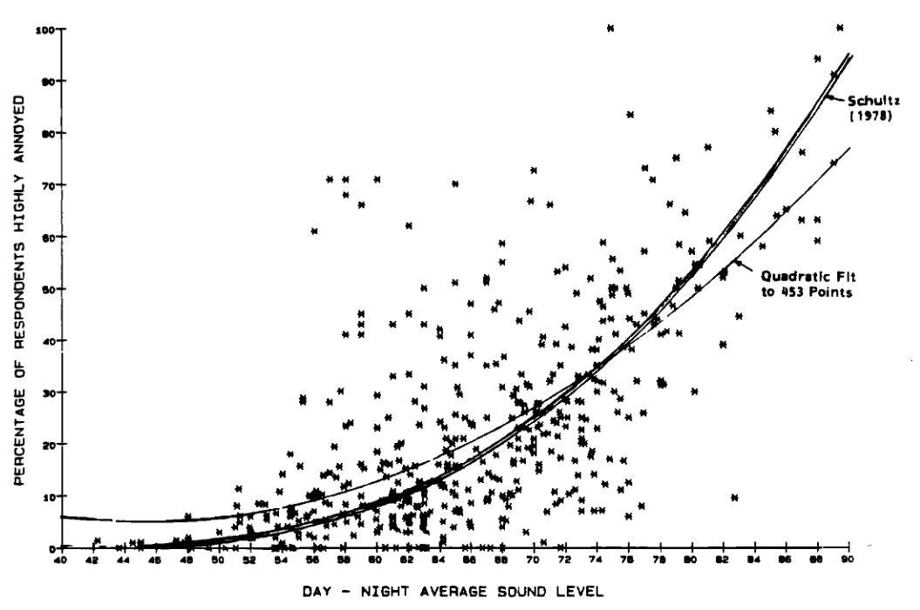
Community Noise, 1995

Slide 5
Night Noise Guidelines for Europe
LOAEL (lowest observed adverse effect level) 40 dB L_{night, outside}
(Night noise guideline)
“Above 55 dB the cardiovascular effects become the major public health concern”
(Interim target)
“we propose to assume that NOEL_{Amax}= 32 dB(A) [in the sleeping room] and set a health-based night-time noise limit that is tolerant for transportation noise events with LAmax~32 dB(A).
“we propose to assume that NOAEL_{Amax}= 42 dB(A) [in the sleeping room] and set a health-based night-time noise limit that does not tolerate transportation noise events with L_{Amax}> 42 dB(A).”

Slide 6
Environmental Noise Guidelines for the European Region 2018 - Status
“The current environmental noise guidelines for the European Region supersede the CNG from 1999. Nevertheless, the GDG recommends that all CNG indoor guideline values and any values not covered by the current guidelines (such as industrial noise and shopping areas) remain valid.”
“the current guidelines complement the NNG from 2009”

Slide 7
Environmental Noise Guidelines for the European Region 2018 – KEY POINTS
The recommended levels are only valid for the specific sources in isolation – road, rail, aircraft, wind farms and leisure
Combination of effects can by done through DALYs (with caution)
The noise levels recommended are incident sound
It is explicitly stated that the recommended levels are not LOAELs
While the CNG indoor levels survive, compliance with them does not avoid the 2018 recommendations if outdoor levels are still exceeded
The benchmarks that produce the lowest recommended levels are not necessarily the most important – incidence of IHD for road traffic
Local is best – most relevant for aircraft noise in the UK

Slide 8
Environmental Noise Guidelines for the European Region 2018 - Status
The 2018 ENG contain two types of recommendation:
Benchmarks – what is an acceptable percentage highly annoyed?
Exposure response functions (ERFs) – what noise levels go with the benchmarks?

Slide 9
The benchmarks
Priority health outcomes and relevant risk increases for setting guideline levels
Priority health outcome measure (associated DW) | Relevant risk increase considered for setting of guideline level
Incidence of IHD (DW: 0.405) 5% RR increase | 5% RR increase
Incidence of hypertension (DW: 0.117) | 10% RR increase
%HA (DW: 0.02) | 10% absolute risk
%HSD (DW: 0.07) | 3% absolute risk
Permanent hearing impairment (DW: 0.0150) | No risk increase due to environmental noise
Reading and oral comprehension (DW: 0.006) | One-month delay in terms of reading age

Slide 10
Outside-inside, façade, free-field or incident?
“In these guidelines, L_{den} and L_{night}
refer to a measurement or calculation of noise exposure at the
most exposed façade, outdoors, reflecting the long-term average exposure.”
“The differences between indoor and outdoor levels are usually estimated
at around 10 dB for open, 15 dB for tilted or half-open and about 25 dB for closed windows.” (ENG)
At night-time, outside sound levels about
1 metre from facades of living spaces should not exceed 45 dB L_{Aeq},
so that people may sleep with bedroom windows open.
This value was obtained by assuming that the noise reduction from
outside to inside with the window open is 15 dB. (CNG)

Slide 11
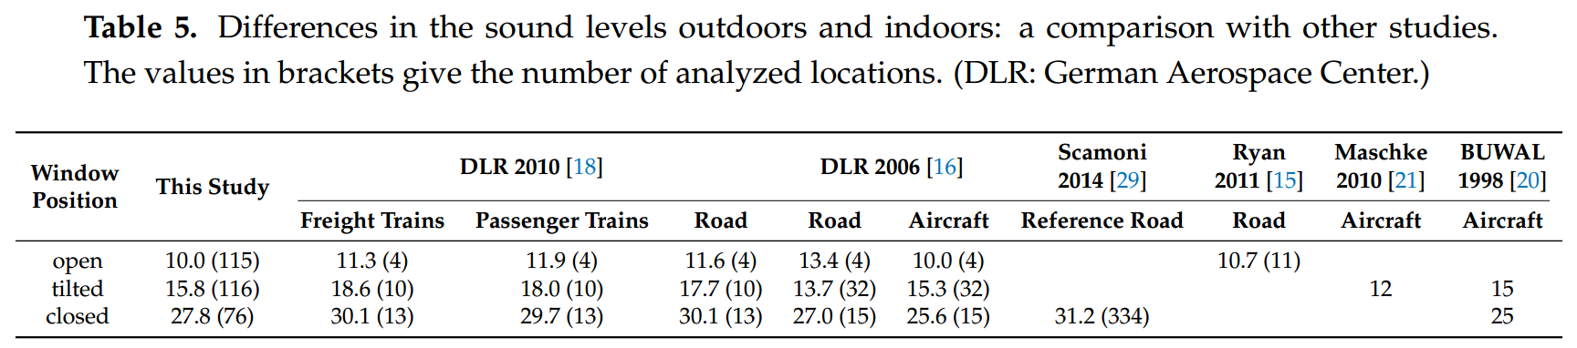
Outdoor - Indoor
Locher B, Piquerez A, Habermacher M, Ragettli M, Röösli M, Brink M et al. (2018). Differences between outdoor and indoor sound levels for open, tilted, and closed windows. Int J Environ Res Public Health. 15(1): 149

Slide 12
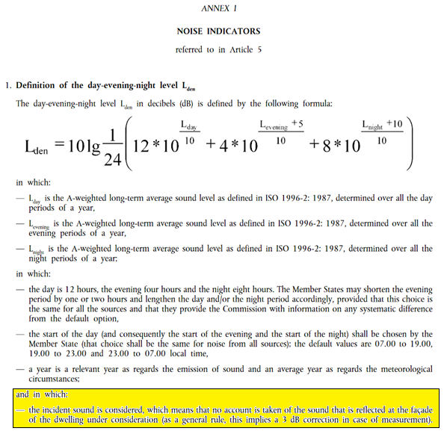
Status of the guidelines

Slide 13
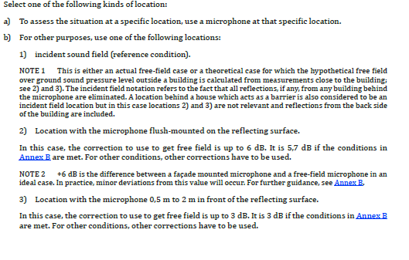
ISO 1996-2:2017

Slide 14
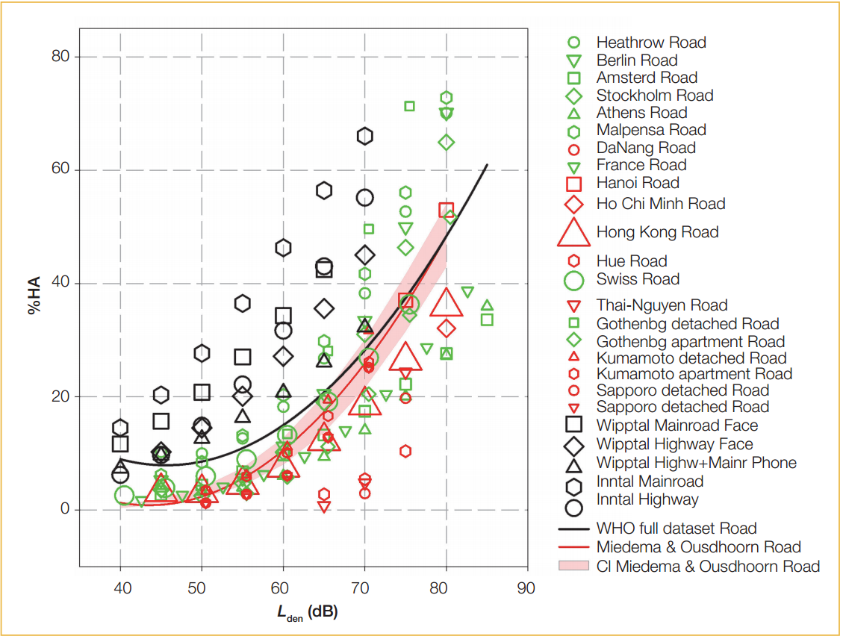
Road traffic noise

Slide 15
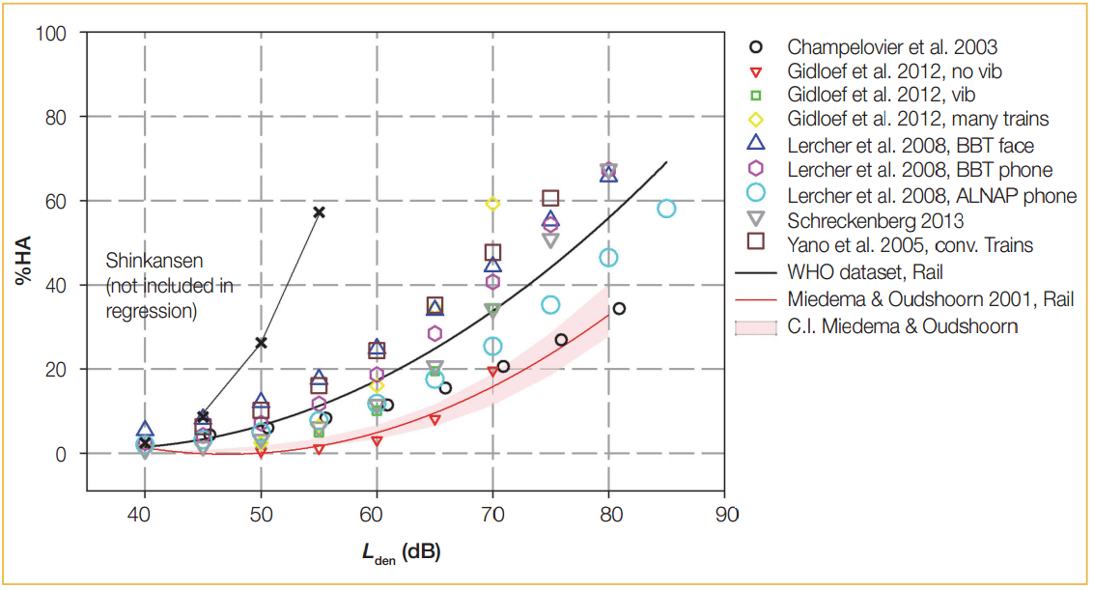
Railway Noise

Slide 16
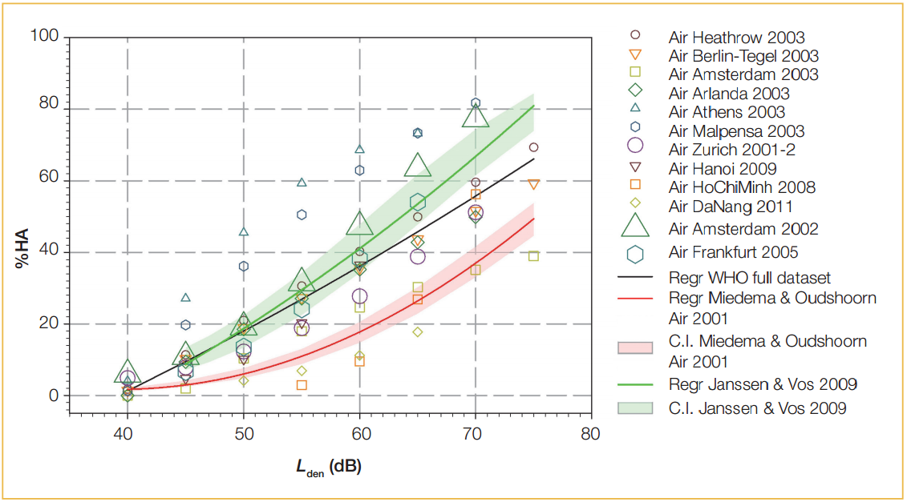
Aircraft Noise

Slide 17
Combined exposure
“the guidelines do not include recommendations about any kind of multiple exposures. In everyday life people are often exposed to noise from several sources at the same time. In Germany, for example, 44% of the population are annoyed by at least two and up to five sources of noise (Umweltbundesamt, 2015). For some health outcomes, such as obesity, new evidence indicates that combined exposure to noise from several means of transportation is particularly harmful (Pyko et al., 2015; 2017)”

Slide 18
Combined exposure
“The results from a health risk assessment are usually reported as the number of attributable deaths, number of cases, years of life lost, years lost due to disability or DALYs.
The quantification of the impacts for one combination of noise source, noise exposure indicator and health outcome may to some extent include effects attributable to another. Consequently, for any particular set of combinations, consideration should be given to potential double counting.”

Slide 19
Combined exposure
“Estimated impacts should not be added together without recognizing that addition will, in most practical circumstances, lead to some overestimation of the true impact. Impacts estimated for only one combination will, on the other hand, underestimate the true impact of the noise mixture, if other sources of noise also affect that same health outcome”

Slide 20
The recommended levels
Source | Strength | Outcome, level for benchmark and quality | Recommended level
Road traffic noise | Strong | IHD 59.3 dB L_{den} High %HA 53.3 dB L_{den} Moderate | 53 dB L_{den} | 45 dB L_{night}
Railway noise | Strong | %HA 53.7 dB L_{den} Moderate | 54 dB L_{den} | 44 dB L_{night}
Aircraft Noise | Strong | IHD 52.6 dB L_{den} Very low %HA 45.4 dB L_{den} Moderate Reading skills and oral comprehension in children 55 dB L_{den} Moderate | 45 dB L_{den} | 40 dB L_{night}
Wind Turbine Noise | Conditional | %HA 45 dB L_{den} Low | 45 dB L_{den}
Leisure noise | Strong | Health effects 70 dB L_{Aeq 24h} | 70 dB L_{Aeq 24h}

Slide 21
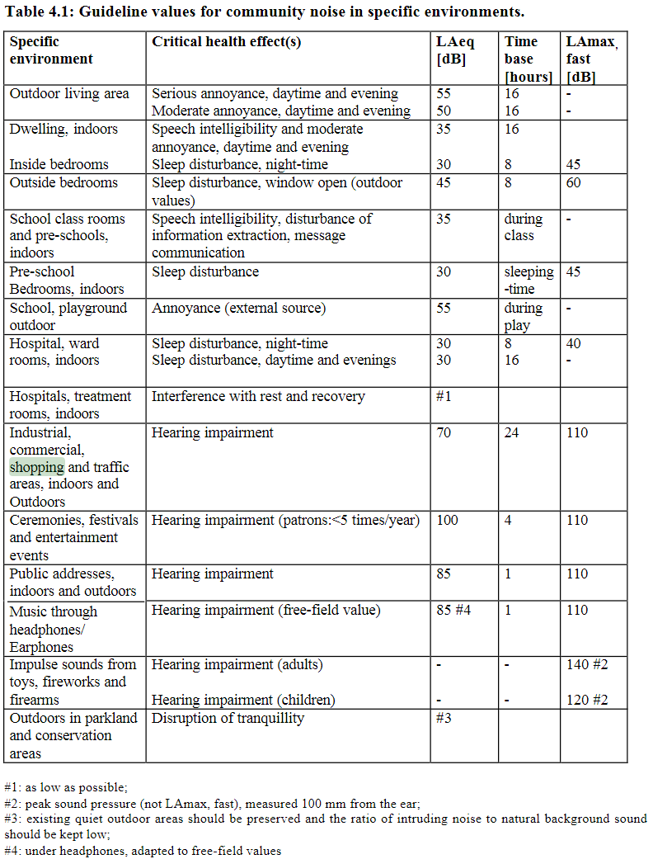
The old guideline values

Slide 22
What’s left of the CNG
Specific Environment | Critical health effect(s) | L_{Aeq} [dB(A)] | Time base [hours] | L_{Amax} fast [dB]
Outdoor living area (noise from sources other than road traffic, railways, aircraft or wind turbines) | Seroius annoyance, daytime and evening Moderate annoyance, daytime and evening | 55 50 | 16 16 | - -
Dwelling, indoors | Speech intelligibility & moderate annoyance, daytime and evening Sleep disturbance, night-time | 35 30 | 16 8 | 45
Outside bedrooms (noise from sources other than road traffic, railways, aircraft or wind turbines) | Sleep disturbance, window open (outdoor values) | 45 | 8 | 60
School class rooms & pre-schools, indoors | Speech intelligibility, Disturbance of information extraction, Message communication | 35 | During Class | -
Pre=school bedrooms, indoor | Sleep disturbance | 30 | Sleeping-time | 45
School playground outdoor | Annoyance (external source) | 55 | During play
Hospital ward rooms, indoor | Sleep disturbance, night-time Sleep disturbance, daytime and evenings | 30 30 | 8 16 | 40 -
Hospitals, treatment rooms, ndoors | Interference with rest and recovery | #1
Outdoor in parkland and conservations areas | Disruption of tranquillity | #3

Slide 23
What’s left of the CNG and what’s new in the ENG
Source | CNG guideline indoors all sources | ENG guideline outdoors noise from specific source only
Road traffic noise | 35 L_{Aeq 16h} 30 L_{Aeq, 8h} | 53 dB L_{den} 45 dB L_{night}
Railway noise | 35 L_{Aeq 16h} 30 L_{Aeq, 8h} | 54 dB L_{den} 44 dB L_{night}
Aircraft noise | 35 L_{Aeq 16h} 30 L_{Aeq, 8h} | 45 dB L_{den} 40 dB L_{night}

Slide 24
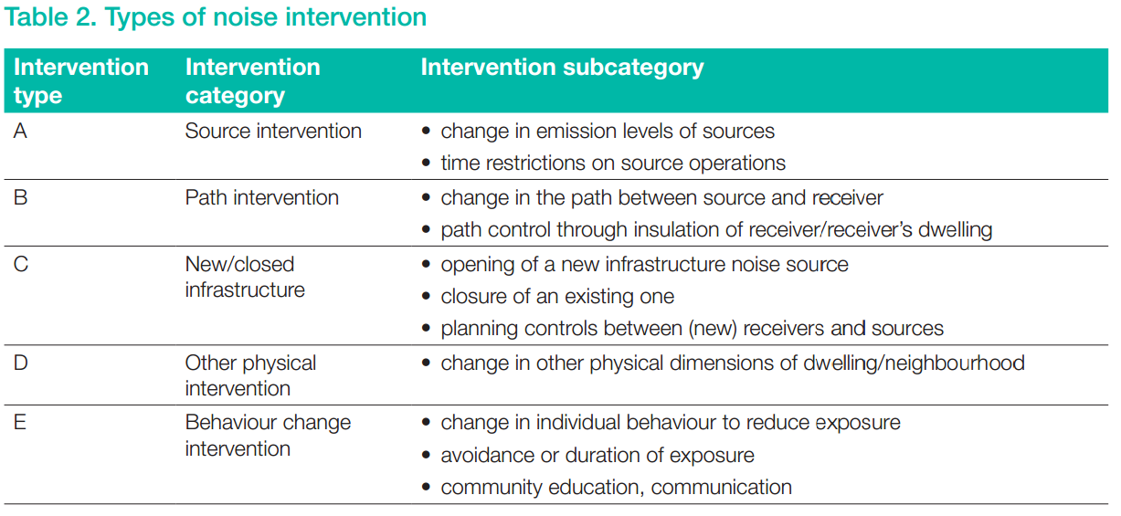
Interventions

Slide 25
Interventions
Road traffic noise:
For specific interventions, the GDG recommends reducing noise both at the source and on the route between the source and the affected population by changes in infrastructure.
Railway noise:
There is, however, insufficient evidence to recommend one type of intervention over another.
Aircraft noise:
For specific interventions the GDG recommends
implementing suitable changes in infrastructure
Wind turbine noise:
No evidence is available, however, to facilitate the recommendation of one particular type of intervention over another.

Slide 26
HM Government’s position
Asked by Ms Harriet Harman MP (Camberwell and Peckham)
On 12 February 2019
“To ask the Secretary of State for Environment, Food and Rural affairs, whether he plans to take steps to meet the World Health Organisation Environmental Noise Guidelines for the European Region 2018. “
Answered by: Dr Thérèse Coffey, Parliamentary Under-Secretary (Department for Environment, Food and Rural Affairs)
“We are working across Government to consider the guidelines and their relevance to future guidance and policy. An officials group is assessing the evidence base as well as other relevant recent research carried out in the UK and abroad, to inform our thinking on this.”

Slide 27
HM Government’s position
Aviation 2050 The future of UK aviation
A consultation
3.106
“There is also evidence that the public is becoming more sensitive to aircraft noise, to a greater extent than noise from other transport sources, and that there are health costs associated from exposure to this noise. The government is considering the recent new environmental noise guidelines for the European region published by the World Health Organisation (WHO). It agrees with the ambition to reduce noise and to minimise adverse health effects, but it wants policy to be underpinned by the most robust evidence on these effects, including the total cost of action and recent UK specific evidence which the WHO report did not assess.”

Slide 28
HM Government’s position
HS2 Phase 2a Additional Provision 2 Environmental Statement:
“ENG18 was published very shortly before the assessment in the SES2 and AP2 ES was completed but it does not lead to a requirement for any changes to the Phase 2a methodology with regard to sound, noise and vibration”

Slide 29
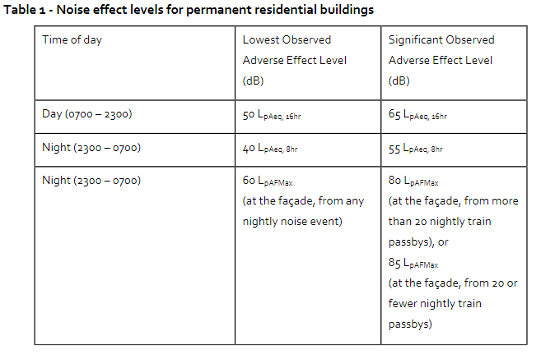
LOAEL and SOAEL
HS2 Phase 2a Information Paper E9

Slide 30
5.5 Methodological guidance for health risk assessment of environmental noise
“cultural differences around what is considered annoying are significant, even within Europe. It is therefore not possible to determine the “exact value” of %HA for each exposure level in any generalized situation. Instead, data and exposure–response curves derived in a local context should be applied whenever possible to assess the specific relationship between noise and annoyance in a given situation.”

Slide 31
The challenges posed
Can we still use the advice: ”During the daytime, few people are seriously annoyed by activities with L_{Aeq} levels below 55 dB; or moderately annoyed with L_{Aeq} levels below 50 dB”?
What use do we make of the recommended levels?
Where does that leave LOAELs and SOAELs?
What is the status of the indoor recommendations of CNG? Can these be reversed to outdoor levels using indoor-outdoor corrections?
Have we got to use L_{den} for everything now?
If the NNG give a different answer, which prevails?
How do we use the Burden of Disease method of calculating DALYs?

Slide 32
The challenges posed
Can we still use the advice: ”During the daytime, few people are seriously annoyed by activities with L_{Aeq} levels below 55 dB; or moderately annoyed with L_{Aeq} levels below 50 dB”?
No. Even in the CNG this generalized recommendation was based on studies of transnportation noise and extending it to outdoor noise in general was not based on rigorous logic. The ENG gives specific recommendations on outdoor noise from each kind of transportation source and although it says that CNG guidelines on sources not covered remain valid, the logic in hollowing out the 55/50 guideline for outdoor noise from sources except road/rail/air traffic is even less rigorous.

Slide 33
The challenges posed
What use do we make of the recommended levels?
In practice, the main use is to apply the associated Exposure Responce Functions to calculate the populations experiencing the benchmark effects, for the purposes of comparing two scenarios, including baseline-v-with development in EIAs.

Slide 34
The challenges posed
Where does that leave LOAELs and SOAELs?
While it is attractive to treat the ENG recommende levels as LOAELs, should that be challenged in an inquiry or a trial, from a forensic point of view the explicit statement in the ENG that the recommendations are not LOELS cannot be avoided.
Unlike SOAEL, the LOAEL concept is established in toxicology, and explicitly used in the NNG.

Slide 35
The challenges posed
From the NNG:
“The no observed adverse effect level (NOAEL) is a concept from toxicology, and is defined as the greatest concentration which causes no detectable adverse alteration of morphology, functional capacity, growth, development or lifespan of the target organism. For the topic of night noise (where the adversity of effects is not always clear) this concept is less useful. Instead, the observed effect thresholds are provided: the level above which an effect starts to occur or shows itself to be dependent on the exposure level. It can also be a serious pathological effect, such as myocardial infarctions, or a changed physiological effect, such as increased body movement.”

