Slide 1
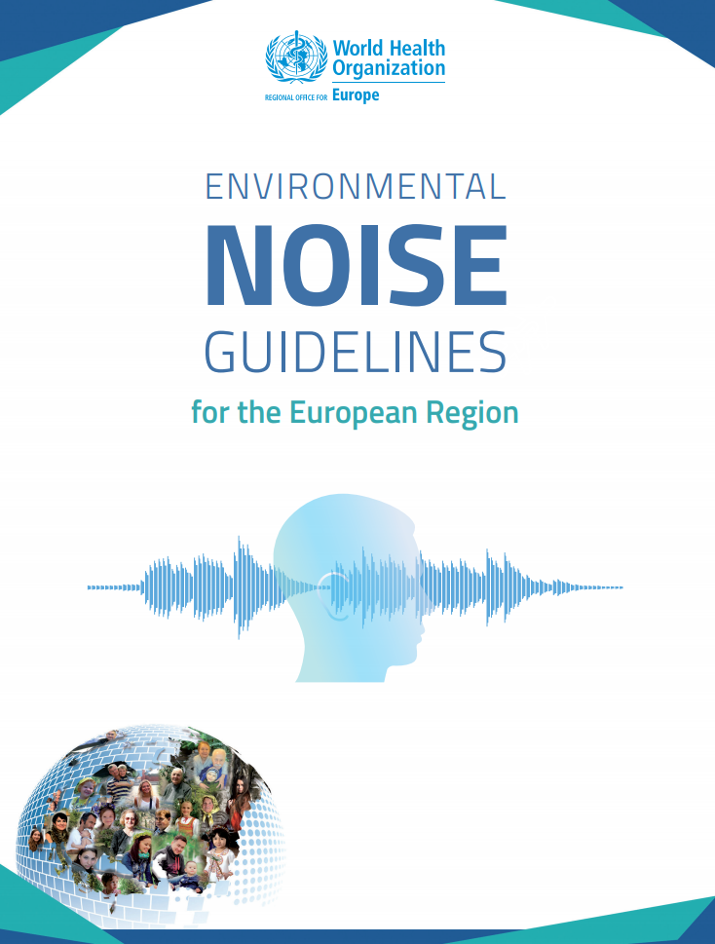
WHO Environmental Noise Guidelines for the European Region Charlotte Clark Associate, Acoustics
Annual Conference 6th June 2019 Manchester

Slide 2
Scope of presentation
Aim of the Guidelines
Methodology used to set the Guidelines
Evidence reviews
What the guidelines say
A few personal thoughts on the guidelines and the evidence review process

Slide 3
Aim of the Guidelines
To provide recommendations for protecting human health from exposure to environmental noise*
Road
Rail
Aircraft
Wind turbine
Leisure noise
Guidelines focus on the WHO European Region but seen to have global relevance/application
* Outdoor noise for all sources, except leisure noise which is indoor and outdoor

Slide 4
Scope of the Guidelines
In the general population exposed to environmental noise, what is the exposure-response relationship between environmental noise (reported as various indicators) and the proportion of people with a validated measure of health outcome, when adjusted for confounders?
In the general population exposed to environmental noise, are interventions effective in reducing exposure to and/or health outcomes from environmental noise?

Slide 5
Scope of the Guidelines
Guidelines are source specific not environment specific
They do NOT include
occupational and industrial noise
neighbourhood noise
combined exposures
hospital noise
The Community Noise Guidelines (1999) still stand for anything not covered in the new Guidelines

Slide 6
Guideline Development
Systematically review scientific evidence
Health effects of environmental noise
Effectiveness of interventions to reduce exposure and improve health
Provide evidence-based recommendations
Exposure - response relationships
Effectiveness of interventions

Slide 7
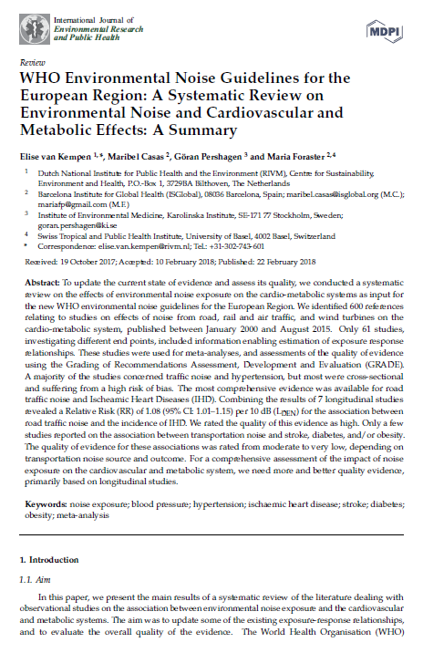
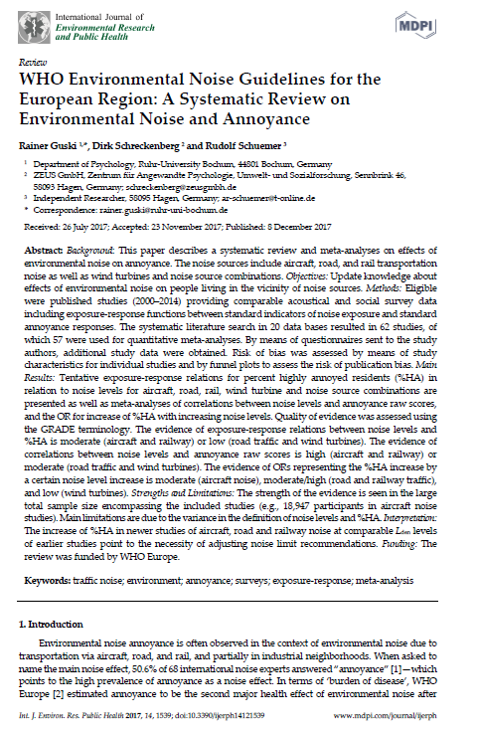
Health outcomes reviewed
Cardiovascular diseases (including diabetes and metabolic effects)
Annoyance
Sleep disturbance
Cognitive impairment
Hearing impairment and tinnitus
Adverse birth outcomes
Quality of life, mental health and wellbeing
Interventions to reduce noise and improve health
All the systematic reviews are free to download in a special issue of the International Journal of Environmental Research and Public Health
https://www.mdpi.com/journal/ijerph/special_issues/WHO_reviews

Slide 8
Health outcomes reviewed
 | Pages – Main paper | Pages – Supplementary material
Cardiovascular diseases inc metabolic | 59 | 0*
Sleep disturbance | 45 | 31
Annoyance | 39 | 73
Cognitive impairment | 23 | 64
Hearing impairment and tinnitus | 19 | 16
Birth outcomes | 16 | 8
Quality of life, wellbeing, mental health | 27 | 40
Interventions | 44 | 27
Page Totals | 272 | 259
Over 500 pages
and that excludes * the RIVM detailed report of 260 pages on cardiovascular diseases

Slide 9
GRADE evidence
For each body of evidence and noise source one evidence rating is provided.
High quality: further research very unlikely to change certainty of effect estimate
Moderate quality: further research is likely to have an important impact on the certainty of the effect estimate and may change the estimate
Low quality: further research is very likely to have an important impact on the certainty of the effect estimate and is likely to change the estimate
Very low quality: any effect estimate is uncertain
Low quality does not necessarily mean that exposure to noise has no effect on the health outcome, but encourages further research to improve the quality of the evidence.

Slide 10
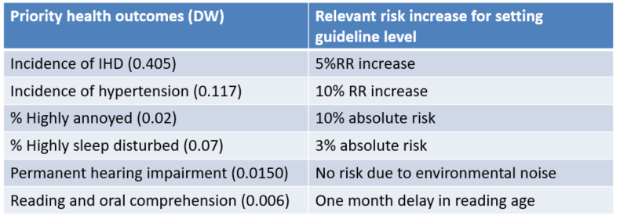
Guidelines relate to a specific increase in risk for a health outcome
Priority health outcomes (DW)
Relevant risk increase for setting guideline level
Most of the guidelines are actually set in relation to a 10% increase in annoyance and 3% increase in sleep disturbance.
Important to appreciate that the new Guidelines are not LOAEL or SOAEL values or limits or caps - they do not indicate where noise effects begin for these health outcomes.
They are noise exposure levels above which the WHO is confident there is an increased risk of adverse health effects
Notes:
Definition: Noise exposure levels above which the WHO is confident there is an increased risk of adverse health effects
Assessment of validity of exposure-response functions (ERF) from systematic reviews
Assessment of lowest noise level measured in the studies reviewed
Assessment of the smallest relevant risk increase for each adverse health outcome
Determination of guideline exposure level based on ERF, starting from lowest level measured and associated with smallest relevant risk increase for adverse health outcomes
Selection of guideline level for each noise source based on priority health outcome with lowest exposure level for that source
Benchmark values, not effect thresholds

Slide 11
Strength of guideline recommendations
A strong recommendation can be adopted as policy in most situations. The guideline is based on the confidence that the desirable effects of adherence to the recommendation outweigh the undesirable consequences. The quality of evidence for a net benefit combined with the other factors – inform this recommendation, which should be implemented in most circumstances
A conditional recommendation requires a policy-making process with substantial debate and involvement of various stakeholders. There is less certainty of efficacy due to lower quality evidence, opposing values and preferences, high resource implications… meaning there may be circumstances or settings in which it will not apply
Priority health outcomes (DW)
Relevant risk increase for setting guideline level

Slide 12
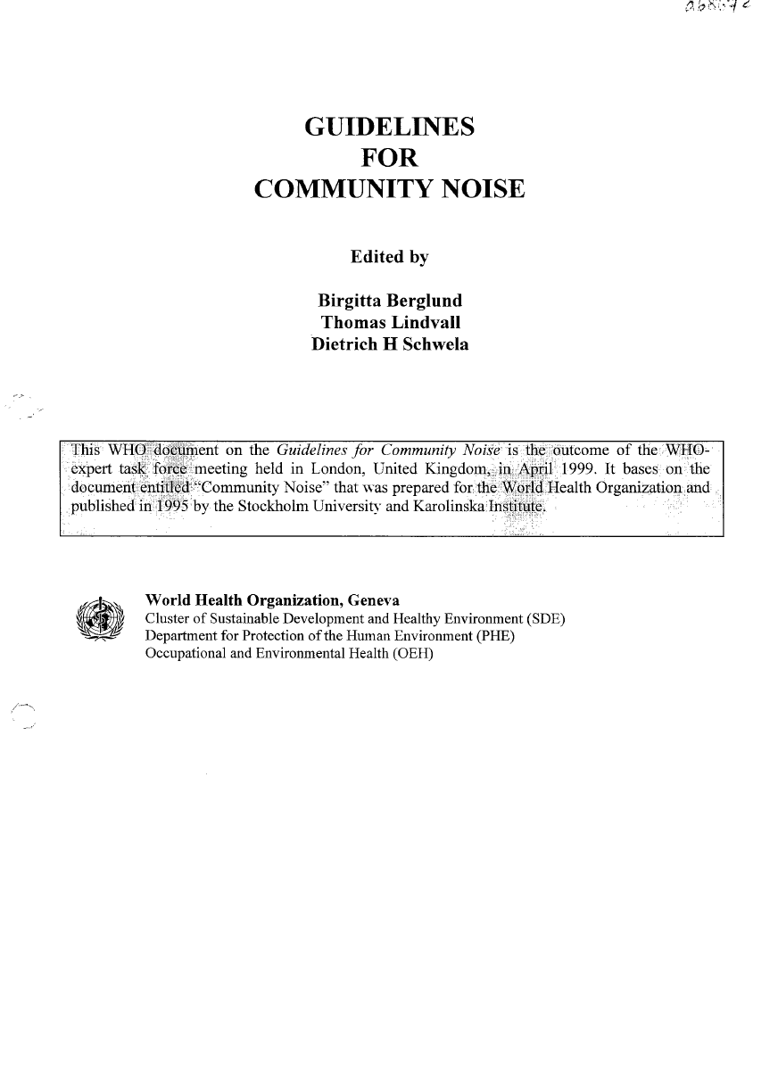
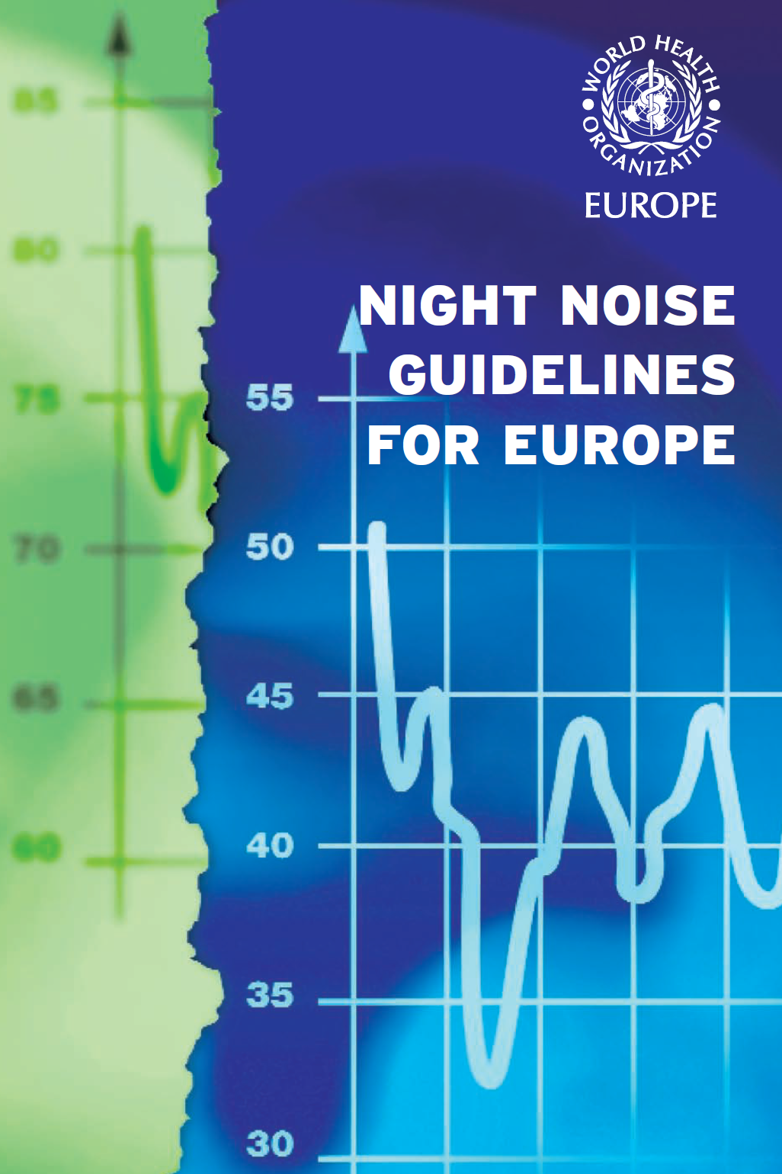
Where do the new Guidelines sit in relation to other WHO Guidelines?
“The current environmental noise guidelines for the European Region supersede the Community Noise Guidelines from 1999. Nevertheless, the GDG recommends that all CNG indoor guideline values and any values not covered by the current guidelines (such as industrial noise and shopping areas) remain valid.”
The current environmental guidelines for the European region complement the Night Noise Guidelines 2009.
GDG= Guideline Development Group

Slide 13
Don’t shoot the messenger….

Slide 14
Headlines
New exposure-response functions for air, road traffic and railway noise for annoyance; cardiovascular outcomes; and sleep disturbance.
Narrative reviews of cognitive impairment; quality of life, wellbeing and mental health; hearing impairment and tinnitus; birth outcomes; and interventions.
Across the board highlights the need for further methodologically robust studies and standardized methodologies, where possible.
Review of interventions - highlights what evidence is available and need for further studies of this nature.
There are still very few papers on combined exposures, yet many people do not live in a one source situation.
This Photo by Unknown Author is licensed under CC BY-SA-NC

Slide 15
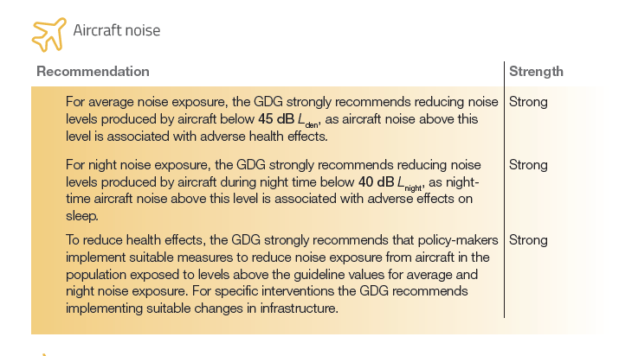
Recommendations for aircraft noise

Slide 16
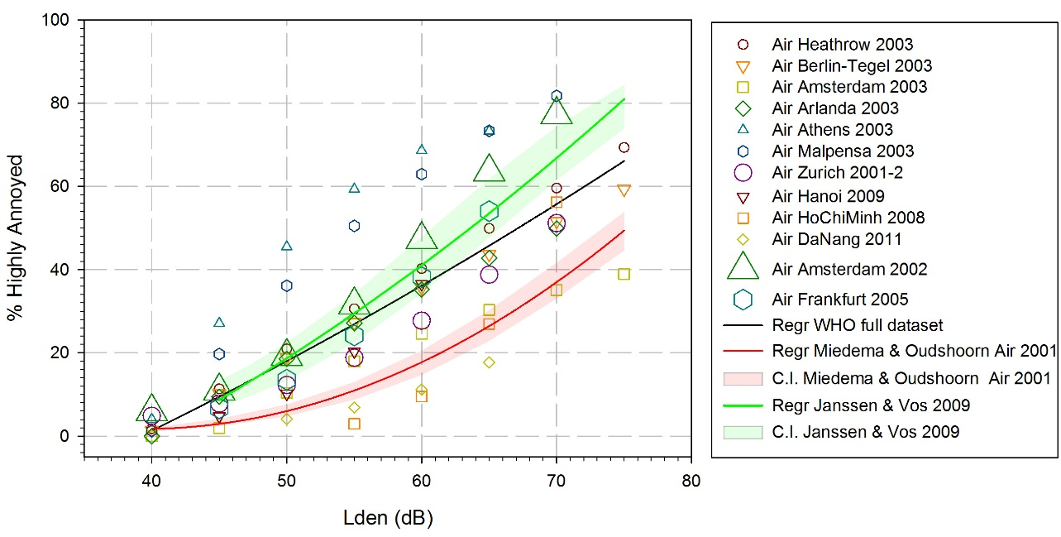
Annoyance – aircraft WHO 2017
WHO 10% HA ~45dB Lden
Figure from Guski et al, 2017, IJERPH

Slide 17
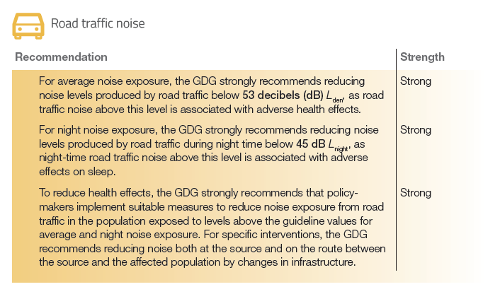
Recommendations for road traffic noise

Slide 18
Recommendations for railway noise

Slide 19
Recommendations for wind turbine noise

Slide 20
Recommendations for leisure noise

Slide 21
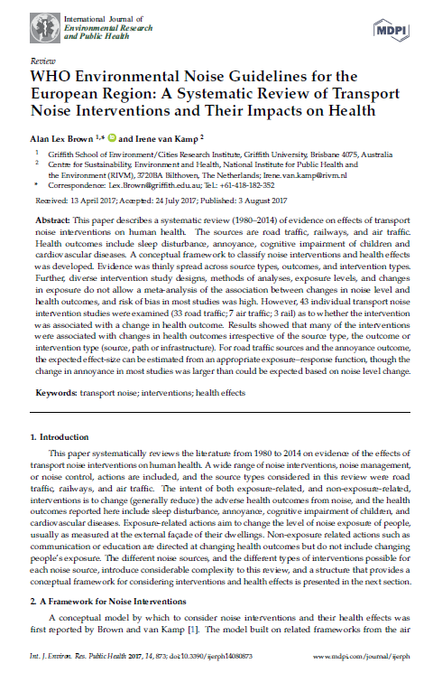
Interventions
Covers publications 1980- 2014
Considers interventions for air, road traffic and railway noise across the range of health outcomes
Many of the interventions were associated with changes in health irrespective of the source type, the outcome or intervention type
Highlights the excess-change response for annoyance
Highlights need for further intervention studies – we have now been saying this for years!!

Slide 22
Annoyance
Notes:
Covers publications 2000- 2014
New meta-analyses and exposure-response functions for air, road, railway, and wind-turbine noise
GRADE quality of evidence of exposure‐response relations between noise levels and %HA is moderate (aircraft and railway) or low (road traffic and wind turbines).
The exposure-response relations for road and railway are similar to past reviews (EU, 2002) but markedly higher for aircraft noise.

Slide 23
Annoyance – aircraft WHO 2017
%HA is ~68% for study Athens airport
%HA is ~10% for study at Ho Chi Minh airport
Comparing the studies, a huge range of % highly annoyed is found for the same Lden dB exposure……
……..should we be drawing a line through these data points?
Figure from Guski et al, 2017, IJERPH

Slide 24
Annoyance – aircraft WHO 2017
WHO 10% HA ~45dB Lden
SoNA 10% HA ~54dB LAeq 16h
Figure from Guski et al, 2017, IJERPH

Slide 25
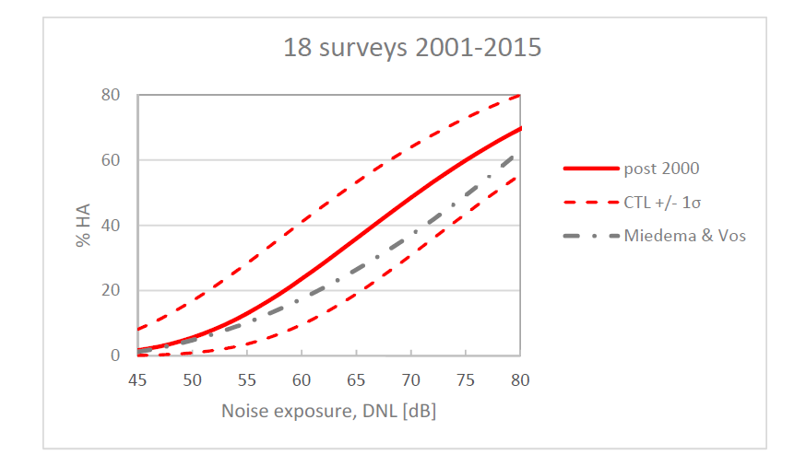
Annoyance – aircraft Gjestland 2018
For this alternative set of data 10% HA corresponds to exposure to aircraft noise at DNL 53.4 dB - substantially higher than the WHO guideline value Lden 45 dB.
However, this paper is NOT a systematic review
10% HA
10% HA
Figure from Gjestland et al, 2018, IJERPH

Slide 26
Annoyance
It is a concern that the strength of the relationship between aircraft noise and annoyance varies greatly depending on which studies are included in the meta-analysis.
The WHO Guidelines suggests that the wide variation between studies because of situational and contextual differences.
The Guidelines state, that for health assessments instead of using the generalised WHO 2017 annoyance ERFs
“…data and exposure-response curves derived in a local context should be applied, whenever possible to assess the specific relationship between noise and annoyance in a given particular situation. If, however, local data is not accessible, the general exposure-response relationships can be applied, assuming that the local annoyance follows the generalized average annoyance.” (Section 5.4)

Slide 27
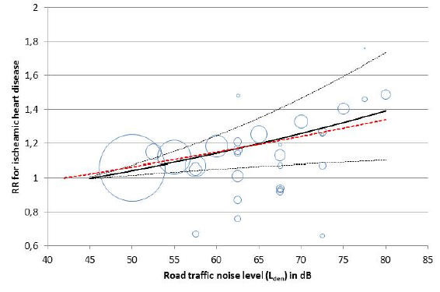
Cardiovascular disease
Basner et al., (2014) estimated that risk for cardiovascular outcomes such as high blood pressure, AMI, and stroke, increases by 7 to 17% for a 10dB increase in aircraft or road traffic noise exposure.
Vinneau et al., (2015) found that risk for incident ischaemic heart disease increased by 4% (95%CI 1.00-1.10) per 10dB L_{den} increase in road traffic noise exposure.
WHO - Relative Risk of 1.08 (95% CI: 1.01–1.15) per 10 dB (Lden) for the association between road traffic noise and the incidence of Ischaemic Heart Disease.
Figure from van Kempen et al, Cardiovascular and metabolic effects of environmental noise, RIVM Report 2017
Notes:
Covers publications January 2000-August 2015
New meta-analyses for a range of cardiovascular outcomes
Lots of studies show an association but many are not methodologically robust
GRADE – studies often low quality
Concludes that the results of this updated review are similar to those of past reviews

Slide 28
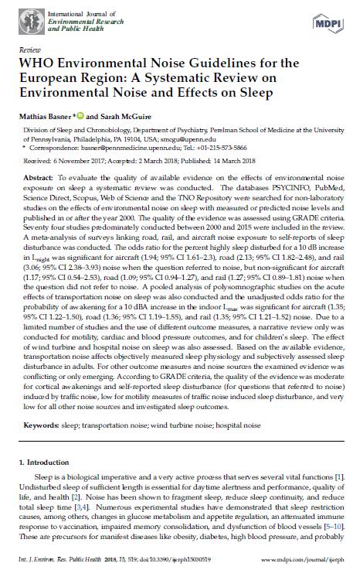
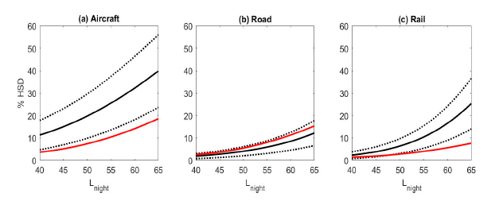
Self-reported sleep disturbance
Noise was associated with self-reports of being highly sleep disturbed when the question referred to noise, but not when the question did not refer to noise.
Figure – ERF for self-reports of noise and high sleep disturbance where the questions referred to noise (black= WHO 2018, red=Miedema EU curve)
Figures Basner and McGuire, 2018, IJERPH

Slide 29
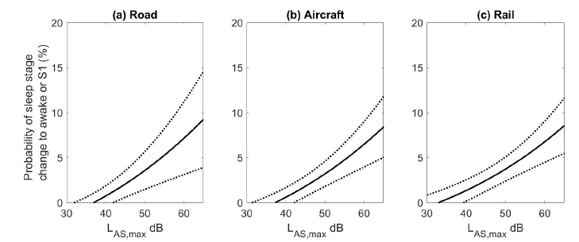
Awakenings - sleep disturbance
The odds ratio for the probability of awakening for a 10 dBA increase in the indoor Lmax was significant for:
aircraft (1.35; 95% CI 1.22–1.50)
road (1.36; 95% CI 1.19–1.55)
rail (1.35; 95% CI 1.21–1.52)
Urgent need for more studies of awakenings given the community importance of this issue.
Figure – Exposure Response Function for probability of additional awakening
Figures Basner and McGuire, 2018, IJERPH

Slide 30
Some personal observations
The setting of the guidelines are driven by the ‘classic’ health outcomes of annoyance and sleep disturbance
The metrics used in the guidelines are not those we need for noise and health assessment to consider the daytime period (leads to converting metrics – see Brink et al, International Journal of Hygiene and Environmental Health 2018)
Lden conflates health effects into the metric
There are benefits of setting guidelines by noise source but this is at the cost of guidelines for specific settings (e.g. is it useful to use Lden for schools?)

Slide 31
Some personal observations
No economic cost-benefit assessment of setting the guidelines at these levels has informed the guidelines. Should we set guidelines for noise and health that ignore the economic and social value of transportation?
Are there enough people involved in the setting of the Guidelines who
1) make noise
2) try and mitigate noise?

Slide 32
Thank you
Any questions?
Charlotte.Clark@arup.com

